Slide 1
Recent Developments in Monetary Economics
Lawrence Christiano
Northwestern University

Slide 2
Overview
A new consensus has emerged about the rough outlines of a model for the analysis of monetary policy.
  Consensus influenced heavily by estimated impulse response functions from Structural Vector Autoregression (SVARs)
Describe empirical SVAR results.
Construction of the consensus models based on results from SVARs.
  Christiano, Eichenbaum and Evans JPE (2005)
  Smets and Wouters, AER (2007)
Further developments of the consensus model
  Labor market
  Financial frictions
  Open economy
Monetary policy analysis: how policy should respond to interest rate spreads, relationship between monetary policy asset market volatility.
Notes:
I’d like to begin by giving you an overview of what my lectures will be about. In recent years a consensus model has emerged in monetary economics. Where the consensus is particularly evident is in the research departments of central banks, all of which are full of recent phd economists. But, you can also see it in the work prominent academic economists, like Mike Woodford, Mark Gertler, Bob King, Jordi Gali, among others. What I want to do is describe that consensus model, explain a little where it came from and what it is good for.
I think any discussion of where it came from has to begin with Vector Autoregressions. The consensus was heavily influenced by the evidence from impulse response functions. So, it is natural for me to begin with a discussion of VARs. Actually, for reasons I’ll explain, the things we can learn from are Structural Vector Autoregressions, or SVARs.
Then I’ll go through the construction of the consensus model based on SVARs. Here, I’ll be doing a selective summary of the papers of CEE and SW.
Even before the current financial crisis started, the consensus model was in the middle of being retooled. This retooling process will get a new shot in the arm from the financial crisis we’re in the middle of. So, I’ll indicate what this retooling is about. I’ll pay particular attention to the introduction of financial frictions.
In the final part of the discussion, which I admit now I may not have time to get to, I want to indicate a fundamental payoff we can get from monetary models, which is to give us insight into fundamental policy questions. I’ll discuss there a perspective one gets on the interaction between monetary policy and asset markets.

Slide 3
Vector Autoregressions
Proposed by Chris Sims in 1970s, 1980s
Major subsequent contributions by others (Bernanke, Blanchard-Watson, Blanchard-Quah)
Useful Way to Organize Data
  VARs serve as a ‘Battleground’ between alternative economic theories
  VARs can be used to quantitatively construct a particular model
Question that can (in principle) be addressed by VAR:
  ‘How does the economy respond to a particular shock?’
  Current consensus model heavily guided by answers to this question
VARs can’t actually address such a question
  Identification problem
  Need extra assumptions….Structural VAR (SVAR).
Notes:
For a recent review of VARs, see http://www.faculty.econ.northwestern.edu/faculty/christiano/research/VAR/web.htm

Slide 4
Outline of SVAR discussion
What is a VAR?
The Identification Problem
Identification restrictions
Results
Historical Decompositions of Data
Notes:
Much of this discussion is based on a Handbook of Macroeconomics (edited by Taylor and Woodford, Elsevier) written by Eichenbaum, Evans and me. A draft of that chapter may be found in http://faculty.wcas.northwestern.edu/~lchrist/research/Handbook/paper2.pdf

Slide 5
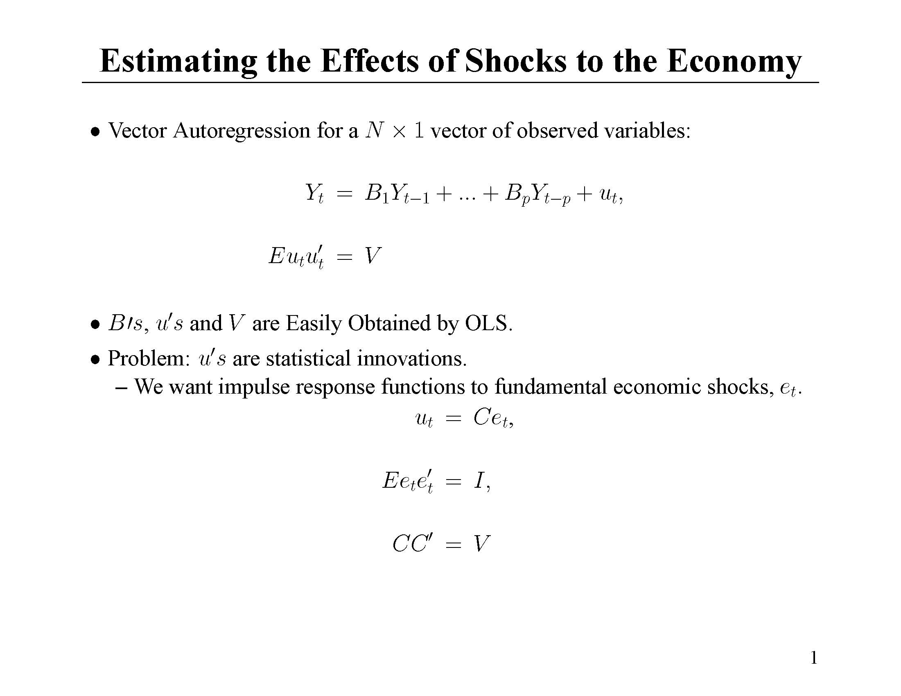

Slide 6
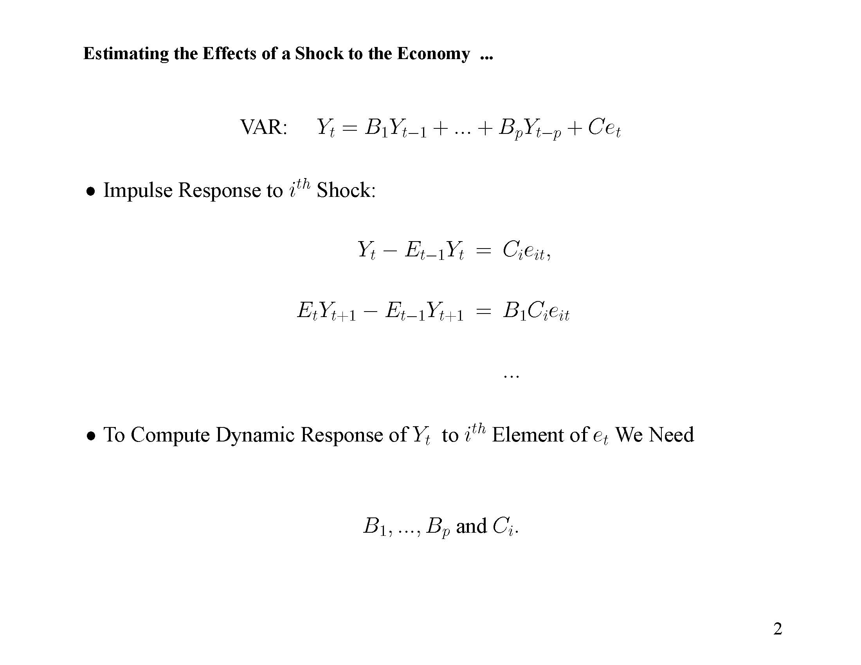

Slide 7
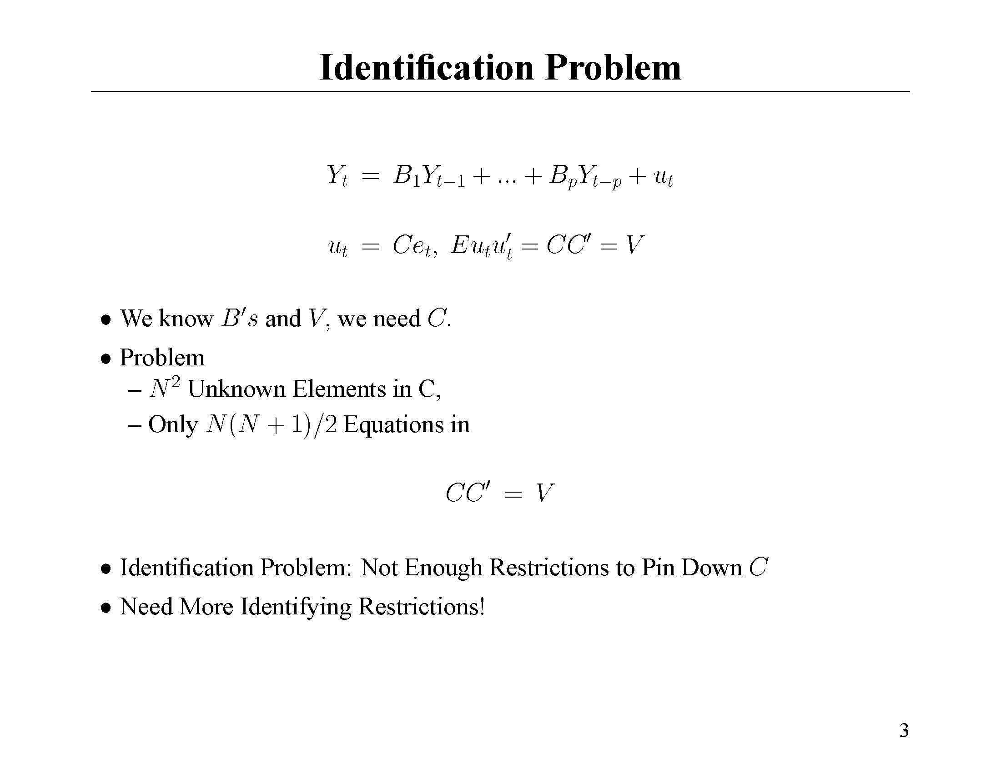

Slide 8
Shocks and Identification Assumptions
Monetary Policy Shock
Neutral Technology Shock
Capital-Embodied Shock to Technology

Slide 9
Identifying Monetary Policy Shocks
One strategy: estimate parameters of Fed’s feedback rule
  Rule that relates Fed’s actions to state of the economy:
  R_{t} = f(Ω_{t}) + e_{t}^{R}
  f linear
  e_{t}^{R} orthogonal to Fed information, Ω_{t}
  Ω_{t} contains current prices and wages, aggregate quantities, lagged stuff
  e_{t}^{R} estimated by OLS regression
  Regress X_{t} on e_{t}^{R}, e_{t-1}^{R}, e_{t-2}^{R} ,…
Fed information set
Policy shock
Notes:
Explain what is a policy shock. Orthogonality assumption very important from a practical point of view. It means that shock does not immediately affect the variables that the fed looks at. Whether you’re happy about that of course depends on what variables you think the Fed looks at. We assume that the only current variables the Fed looks at are prices and wages and things like aggregate employment and also lagged stuff. It probably makes sense to think that the fed does not have an appreciable impact on current prices, wages, output, employment and so on. But, if the fed looked in a systematic way at the stock market and exchange rate too, then the orthogonality assumption would be a problem. When it comes to the US, this is probably a good assumption. For other countries, say Germany before the ECB, it is probably not a very good assumption at all. There is a literature about that. Roubini wrote an early paper about this.
Once you have the shocks in hand, you could in principle then regress whatever variable you like, X, on the current and past values of the shock, to recover the dynamic response of X to the shock. The orthogonality assumption in the shock is crucial here. In practice, this is not an efficient way to compute impulse response functions.

Slide 10
Identification of Technology Shocks (Blanchard-Quah, Fisher, JPE 2007)
There are two types of technology shocks: neutral and capital embodied
These are only shocks that can affect labor productivity in the long run.
The only shock which also has a long run effect on the relative price of capital is a capital embodied technology shock (V_{t}).
Notes:
These assumptions require that the variables in the VAR be covariance stationary. Further elaboration on how these assumptions are useful at cracking the identification problem appear in notes on my website…. http://faculty.wcas.northwestern.edu/~lchrist/course/lecture1.htm, and http://faculty.wcas.northwestern.edu/~lchrist/course/lectureVARpart1.pdf

Slide 11
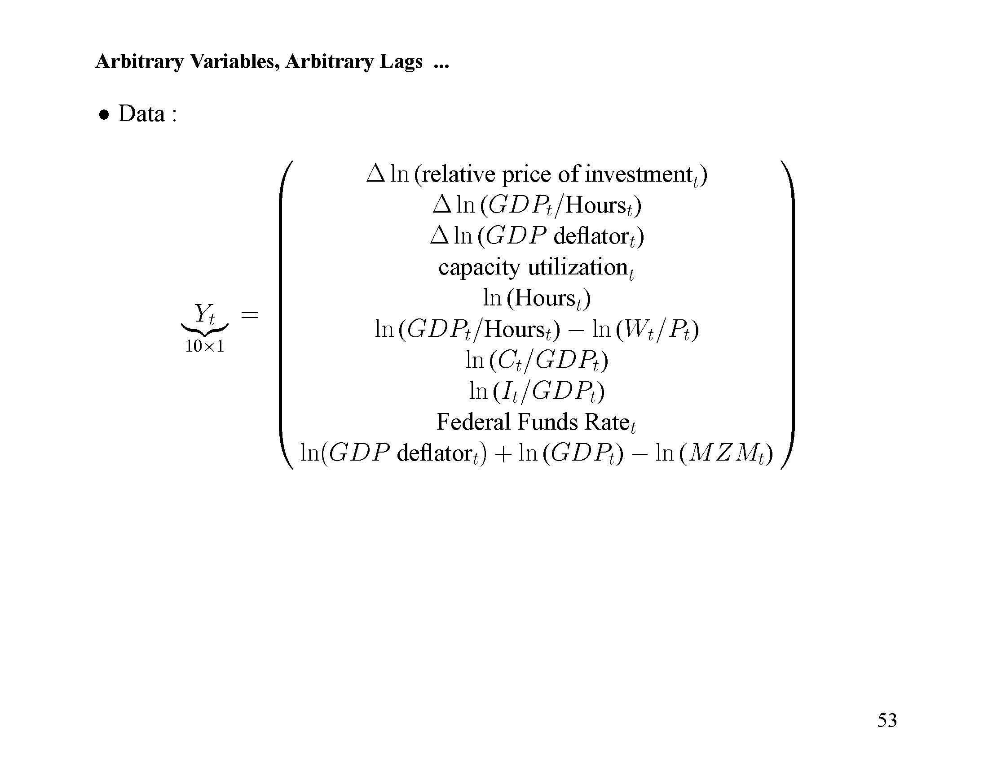
VAR estimation with the following data:
The data have been transformed to ensure stationarity
Sample period: 1959Q1-2007Q1

Slide 12
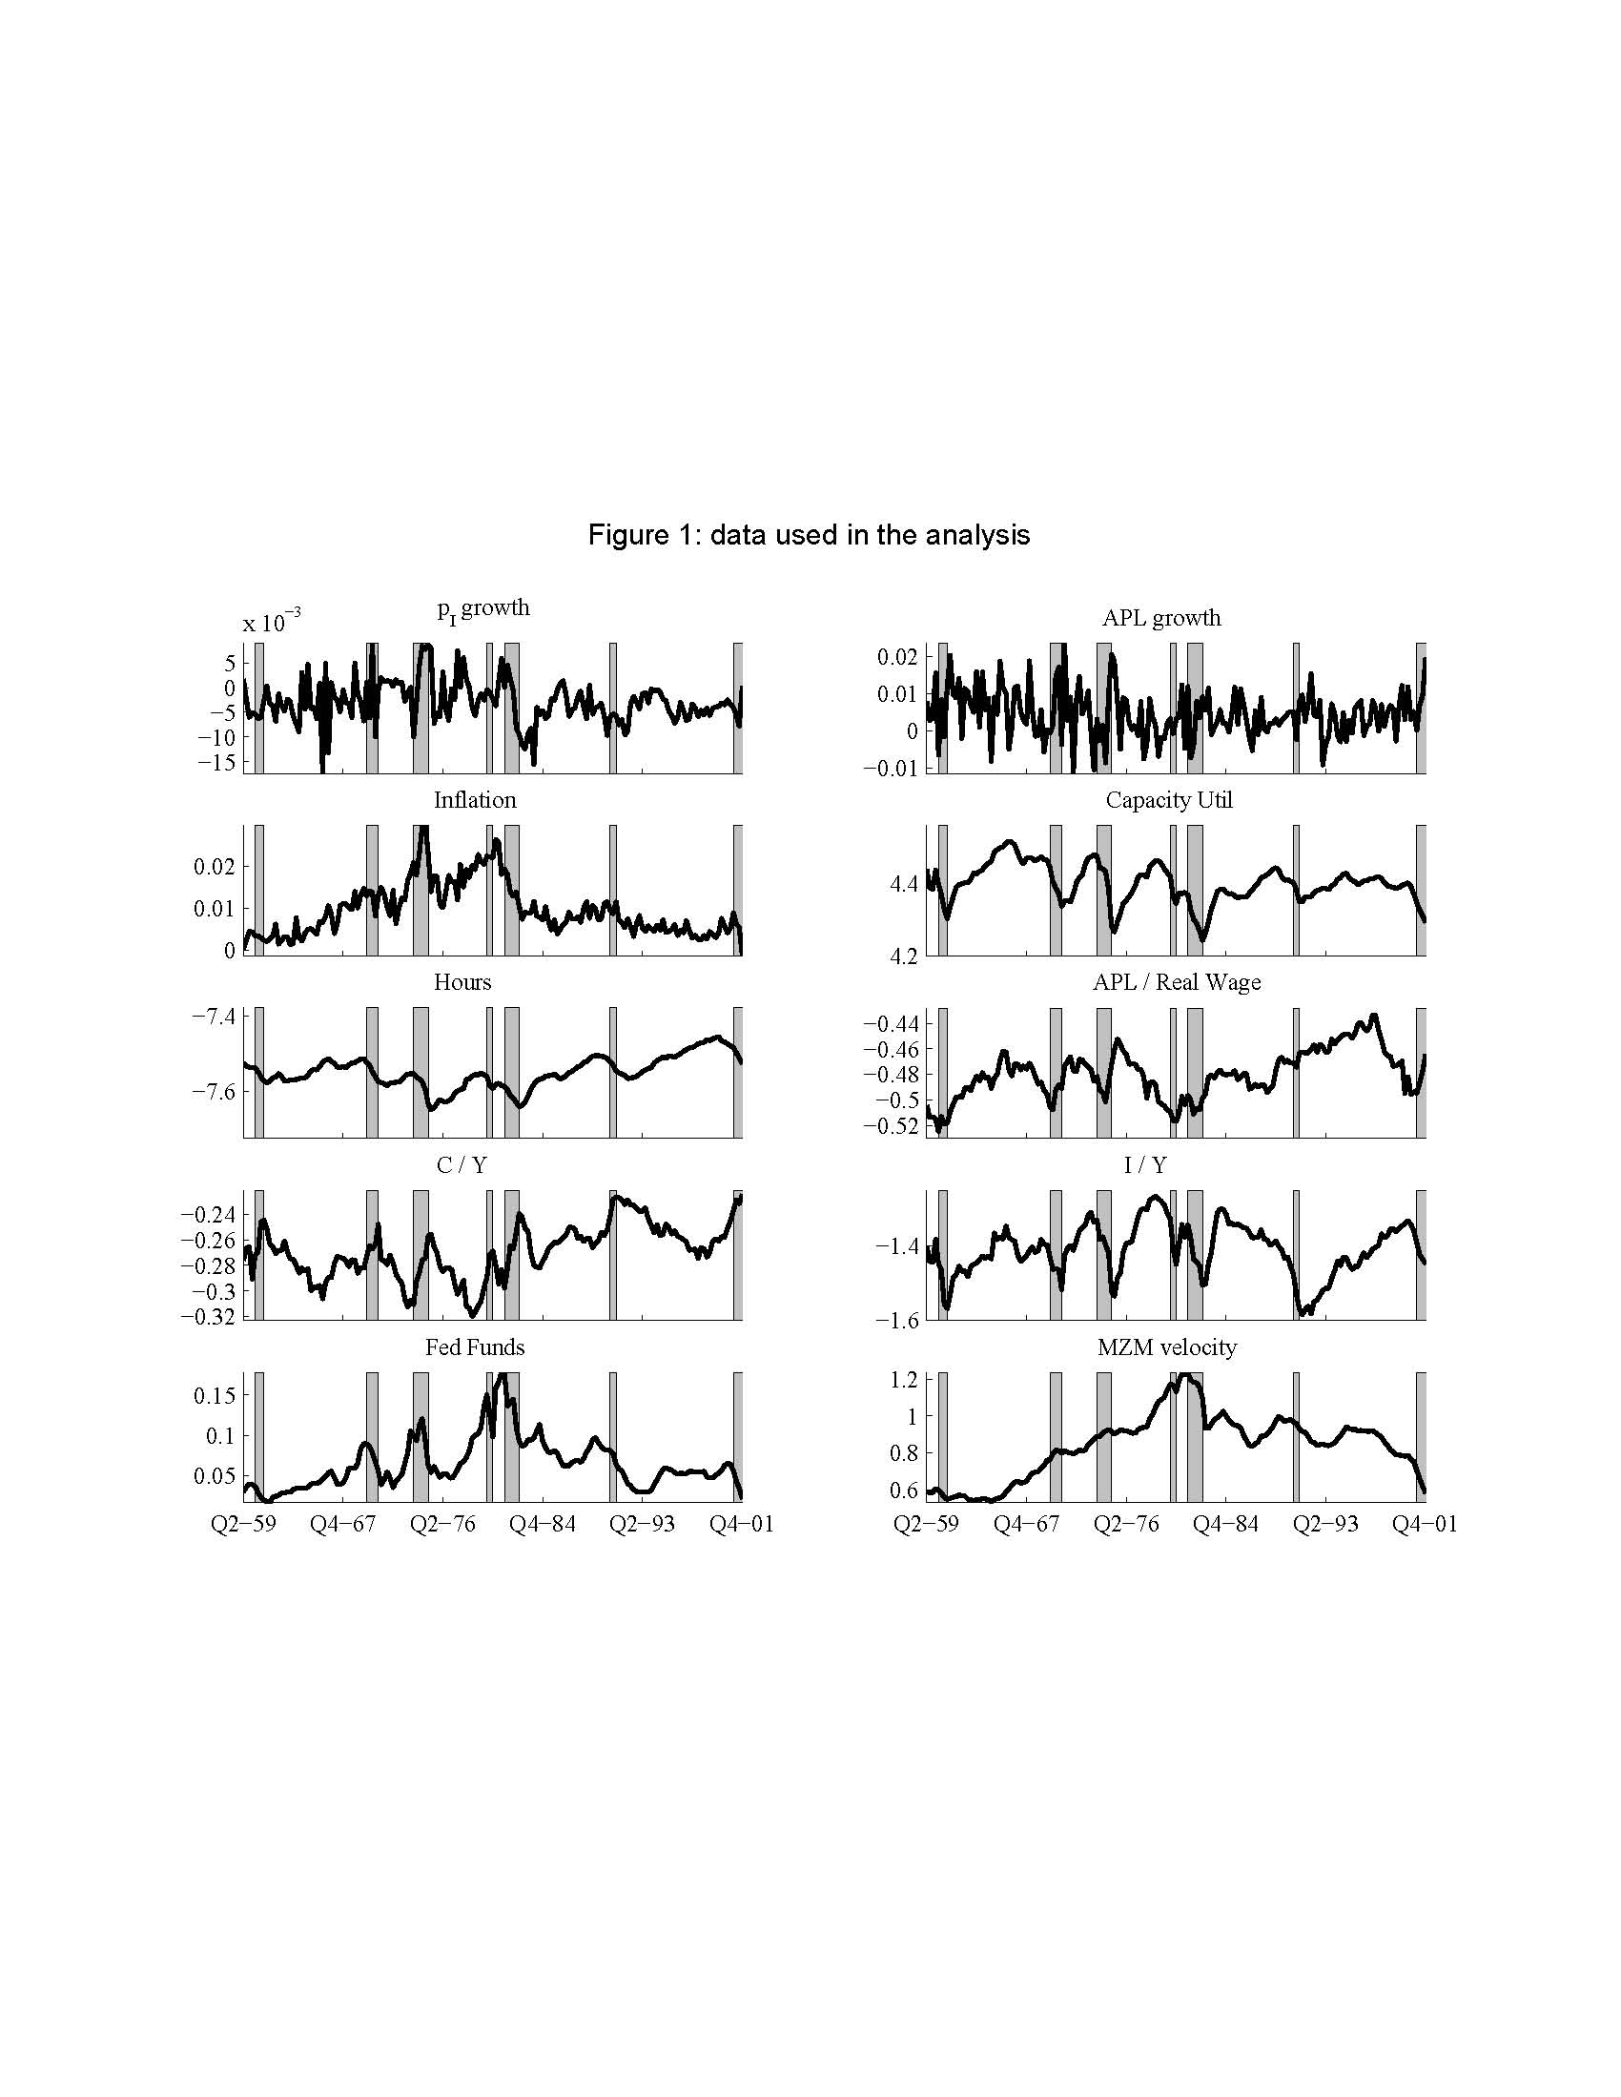
Notes:
Let’s look at the data. We should bear in mind the assumptions that we will make about these data, covariance stationarity. Substantial failure of the assumptions can create problems. We can never be perfectly certain that our assumptions are correct. All we can do is to be on guard, and perhaps try different assumptions and work on robustness. Very different assumptions about the data were made in CEE, and substantially the same results for the response to monetary shocks are reported there. In my work with Eichenbaum and Vigfusson, I’ve explored other sensitivity of conclusions to other aspects of these data.
Mention the PI growth, which is sort of countercyclical. This is the price of aggregate investment, which is appropriate to the model. The price of equipment and consumer durables is even more countercyclical. These findings have let to the view that supply shocks in the investment goods industry – investment specific shocks – may be important in business fluctuations.

Slide 13
Whether
per capita hours
are stationary
has stimulated
much debate
Notes:
Eichenbaum, Vigfusson and I have applied statistical procedures that convince me that hours should better be treated as stationary, but this is still an open discussion. Fernauld has raised a challenge to us, which we have not yet responded to. I believe we can mount an effective response, but we have not yet done so. See http://faculty.wcas.northwestern.edu/~lchrist/research/cev/mitpressstyle.pdf, http://www.faculty.econ.nwu.edu/faculty/eichenbaum/research/CEV.pdf

Slide 14
Inflation a
little non-
stationary
Notes:
The fact that similar results are reported in CEE is some comfort that proceeding as though inflation is stationary may not be a huge problem. But, one never knows for sure and this deserves a closer look.

Slide 15
Sort of
stationary
US trade
Balance
issue
Notes:
Here is the famous current account problem that hit starting in 1982! Our model (a closed economy model) will have little to say about it. For now, we just ignore this. But, when all the results are in, this is something we need to worry about. Maybe this has an influence on our results.

Slide 16
Note how high rates
tend to precede recessions
Notes:
Perhaps this is the fundamental reason why people believe monetary shocks may be important in business cycle fluctuations. Our VAR analysis will find that they are important, and this graph makes that finding no surprise.

Slide 17
Moves with
Interest
rate
Notes:
This augurs well for the model of money demand that is used in the paper.

Slide 18
Results…..

Slide 19
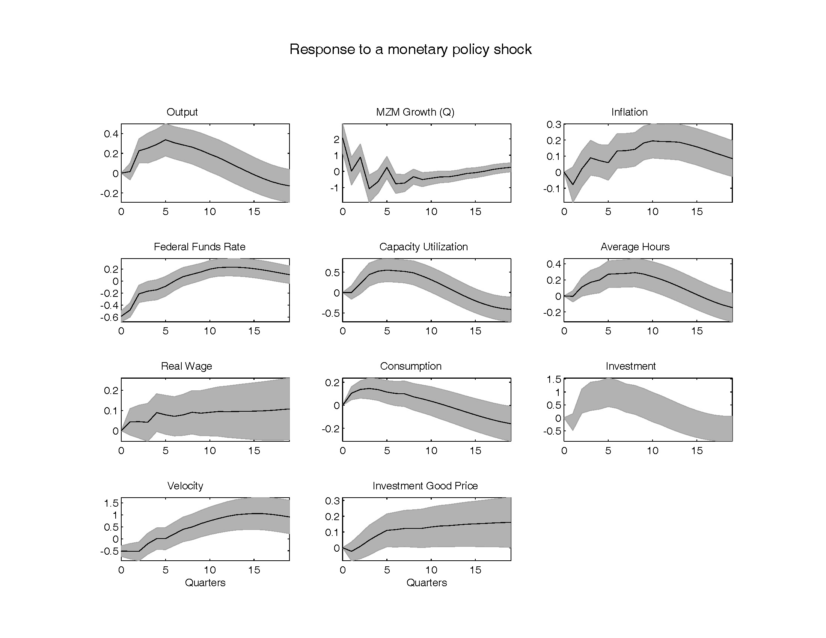

Slide 20
Lots of persistence!

Slide 21
Inflation very slow to respond!

Slide 22
Lots of hump-shapes

Slide 23
Interesting Properties of Monetary Policy Shocks
Plenty of endogenous persistence:
  money growth and interest rate over in 1 year, but other variables keep going….
Inflation slow to get off the ground: peaks in roughly two years
  It has been conjectured that explaining this is a major challenge for economics
  Chari-Kehoe-McGrattan (Econometrica), Mankiw.
  Kills models in which movements in P are key to monetary transmission mechanism (Lucas misperception model, pure sticky wage model)
  Has been at the heart of the recent emphasis on sticky prices.
Output, consumption, investment, hours worked and capacity utilization hump-shaped
Velocity comoves with the interest rate

Slide 24
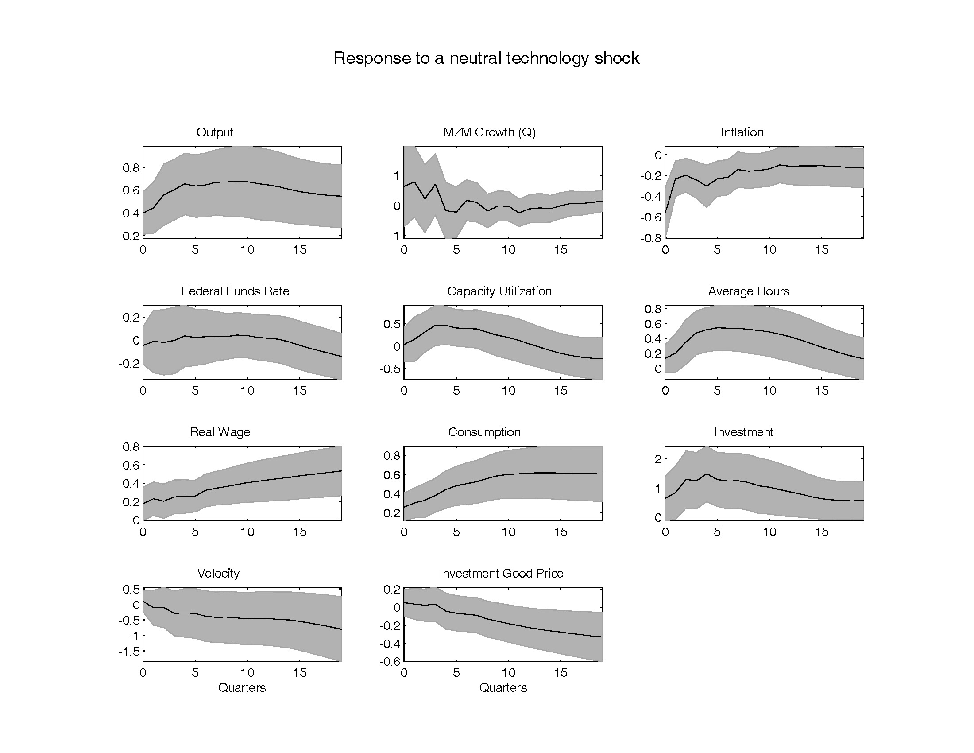
Notes:
Random walk-ish response of output to tech shock. Big drop in inflation. Rhys Mendes has a story that has the potential to explain this. Trying to build on recent work of Lorenzoni to get an information-based reason to explain everything.

Slide 25
Confidence intervals are
wide, as you’d expect given
the nature of the question
being asked
Notes:
Random walk-ish response of output to tech shock. Big drop in inflation. Rhys Mendes has a story that has the potential to explain this. Trying to build on recent work of Lorenzoni to get an information-based reason to explain everything.

Slide 26
Output shows random walk
response
Hours responds positively
Notes:
Random walk-ish response of output to tech shock. Big drop in inflation. Rhys Mendes has a story that has the potential to explain this. Trying to build on recent work of Lorenzoni to get an information-based reason to explain everything.

Slide 27
Inflation exhibits a quick
response. Raises a potential
challenge, and draws attention
to alternative approaches.
Notes:
Random walk-ish response of output to tech shock. Big drop in inflation. Rhys Mendes has a story that has the potential to explain this. Trying to build on recent work of Lorenzoni to get an information-based reason to explain everything.

Slide 28
Observations on Neutral Shock
Generally, results are ‘noisy’, as one expects.
  Interest, money growth, velocity responses not pinned down.
Interestingly, inflation response is immediate and precisely estimated.
Does this raise a question about the conventional interpretation of the response of inflation to a monetary shock?
Alternative possibility: information confusion stories.
  A variant of recent work by Rhys Mendes that builds on Guido Lorenzoni’s work.

Slide 29
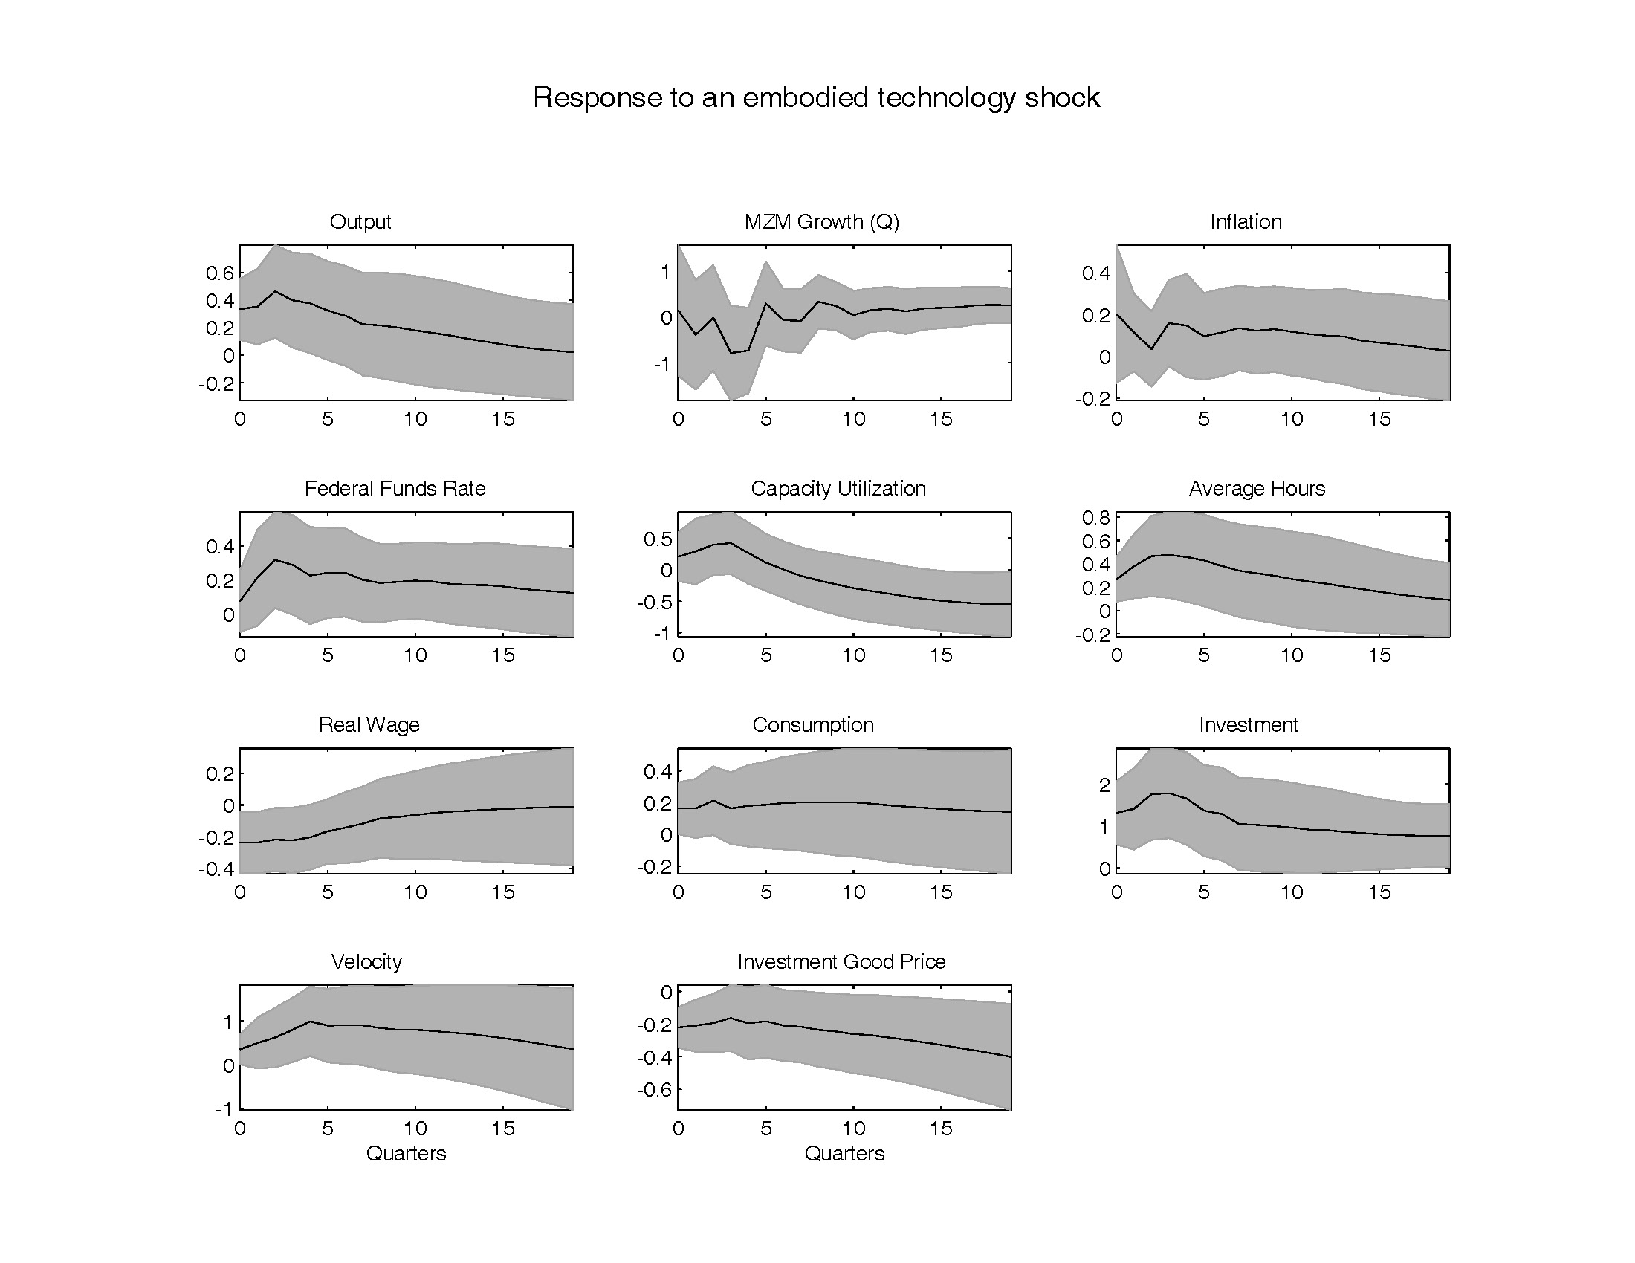

Slide 30
Warning: confidence intervals
are wide! Econometric model
estimation will take this into
account.

Slide 31
Historical Decomposition of Data into Shocks
We can ask:
  What would have happened if only monetary policy shocks had driven the data?
  We can ask this about other identified shocks, or about combinations of shocks
  We find that the three shocks together account for a large part of fluctuations

Slide 32
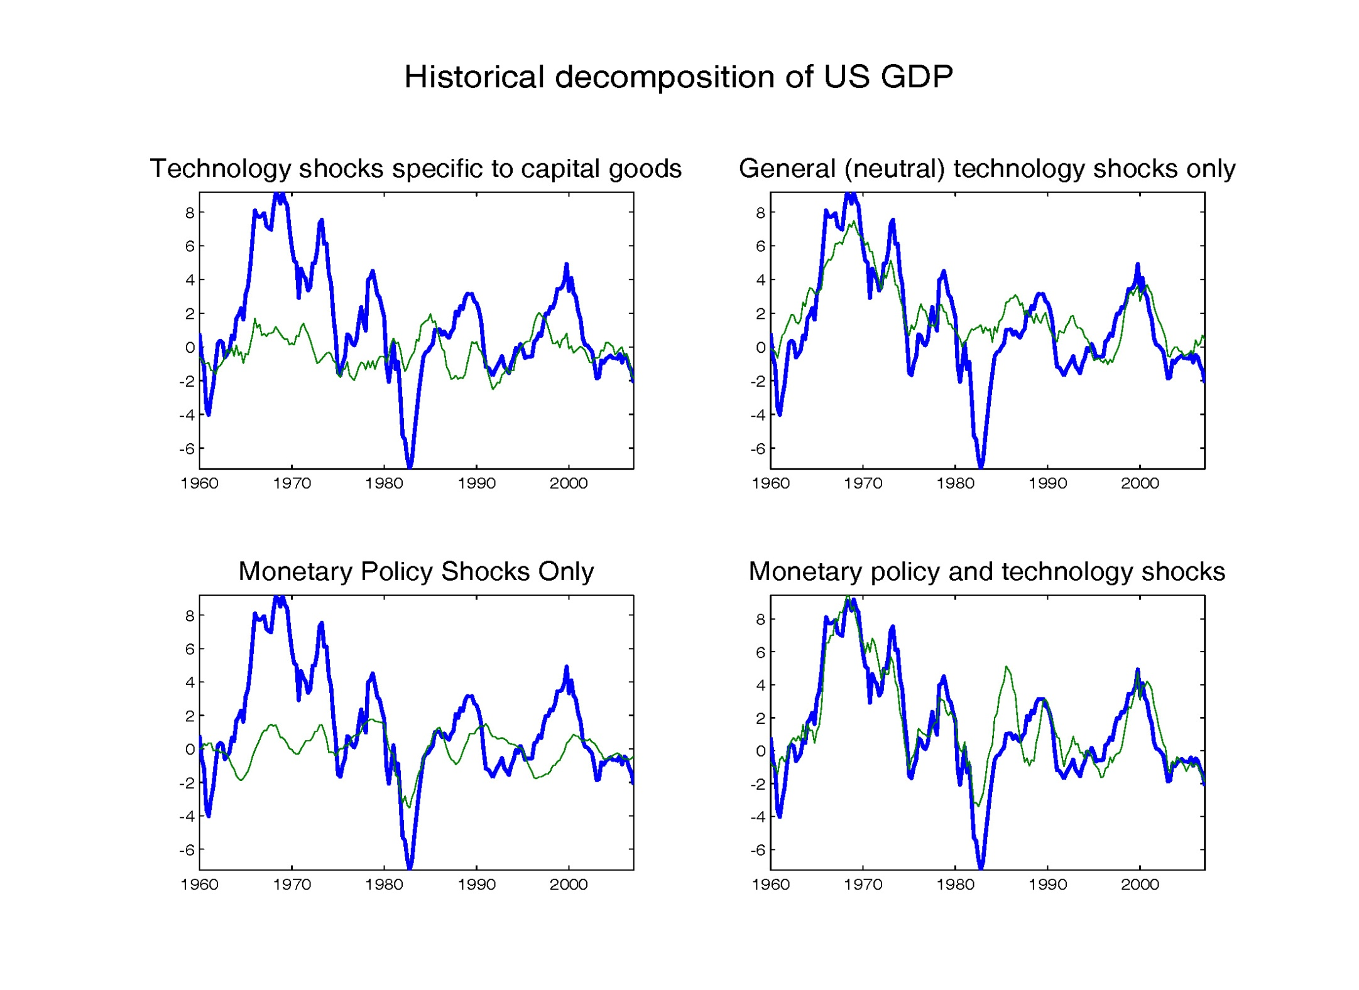
Dark line: detrended actual
GDP
Thin line: what GDP would have been if there had only
been one type of technology shock, the type that
affects only the capital goods industry
These shocks have some effect, but not terribly important

Slide 33
Type of technology shock that affects
all industries
This has very large impact on broad trends in the
data, and a smaller impact on business cycles.
Has big impact on trend in data, and 2000 boom-bust

Slide 34
Monetary policy shocks have a big impact on 1980 ‘Volcker recession’

Slide 35
All three shocks together account for large part of business cycle

Slide 36
Variance Decomposition

Slide 37
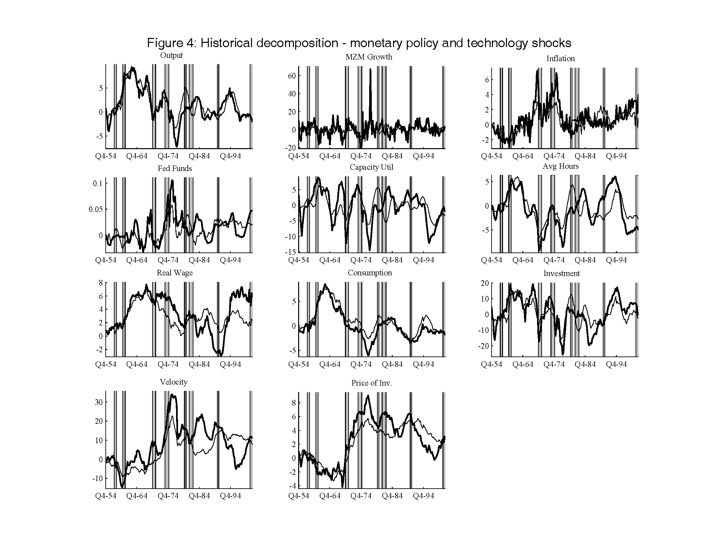

Slide 38
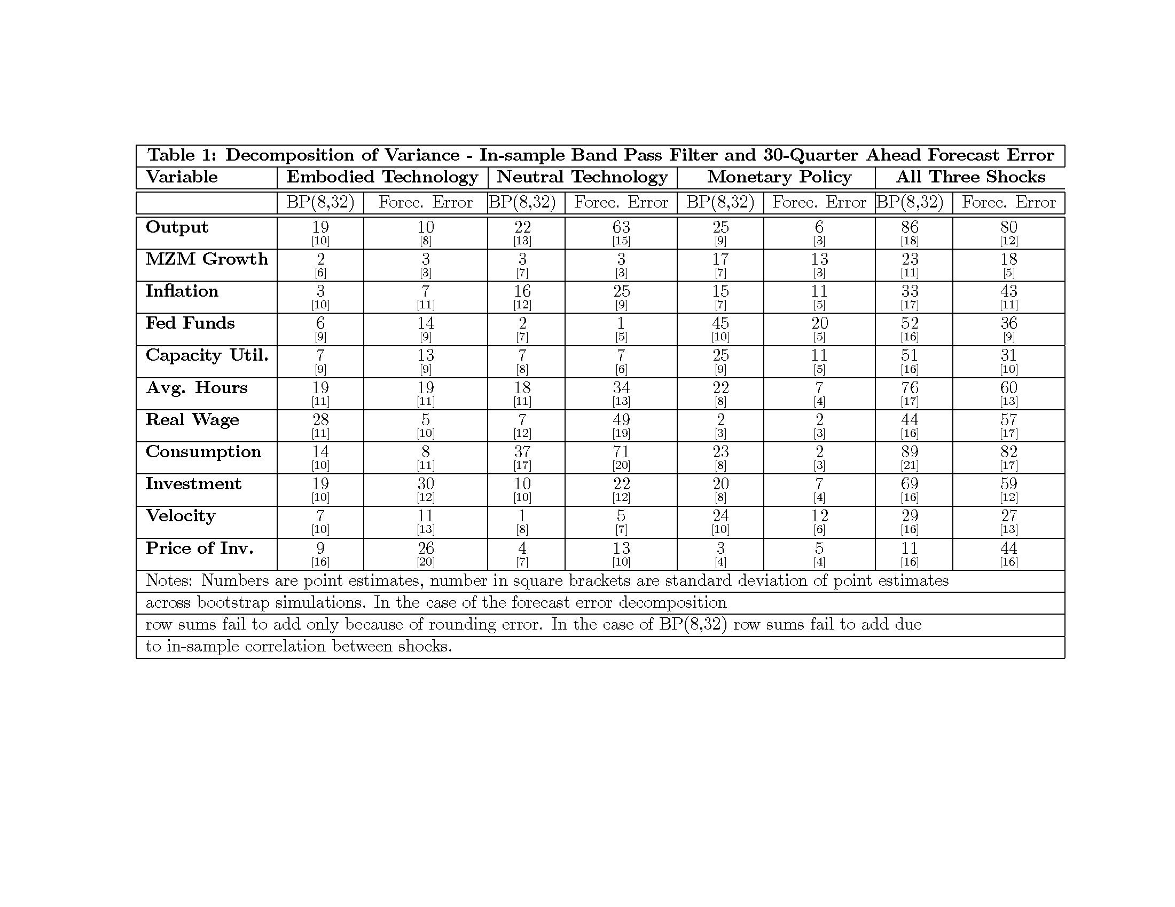

Slide 39
Now, to the construction of a monetary equilibrium model, based on the previous impulse response functions….
Based on
  Christiano-Eichenbaum-Evans JPE(2005)
  Altig-Christiano-Eichenbaum-Linde
Notes:
For CEE, see http://faculty.wcas.northwestern.edu/~lchrist/research/modeling/publication.pdf
For ACEL, see http://faculty.wcas.northwestern.edu/~lchrist/research/ACEL/acelweb.htm

Slide 40
Objectives
Constructing a standard (‘consensus’) DSGE Model
  Model features.
  Estimation of model using impulse responses from SVAR’s.
Determine if there is a conflict regarding price behavior between micro and macro data.
  Macro Evidence:
    Inflation appears sluggish
    Inflation responds slowly to monetary shock
  Micro Evidence:
    Bils-Klenow, Nakamura-Steinsson report evidence on frequency of price change at micro level: 5-11 months.

Slide 41
Description of Model
Timing Assumptions
Firms
Households
Monetary Authority
Goods Market Clearing and Equilibrium

Slide 42
Timing
Technology Shocks Realized.
Agents Make Price/Wage Setting, Consumption, Investment, Capital Utilization Decisions.
Monetary Policy Shock Realized.
Household Money Demand Decision Made.
Production, Employment, Purchases Occur, and Markets Clear.
Note: Wages, Prices and Output Predetermined Relative to Policy Shock.

Slide 43
Notes:
Here is the general structure of the standard model. The structure is driven largely by the desire to get some price frictions into the model, and this is motivated by the VAR evidence that prices respond only slowly to a monetary shock. But, price frictions require price setting. And this in turn requires market power. But, if we introduce market power we don’t want to get trap into a situation where there is just one monopolist! So, we use the Dixit-Stiglitz setup to allow for monopoly power but with that power suffused over lots of firms.

Slide 44
Erceg-Henderson-Levin
labor market.
Notes:
Perspective on the labor market is the same as for the goods market. Lots of monopoly power suffused across lots of agents. We’ll re-examine this later when we talk about extensions of the model. This labor market part of the model has received a lot of attention, and much work has gone into developing it further. This model is due to Erceg-Henderson-Levin.

Slide 45
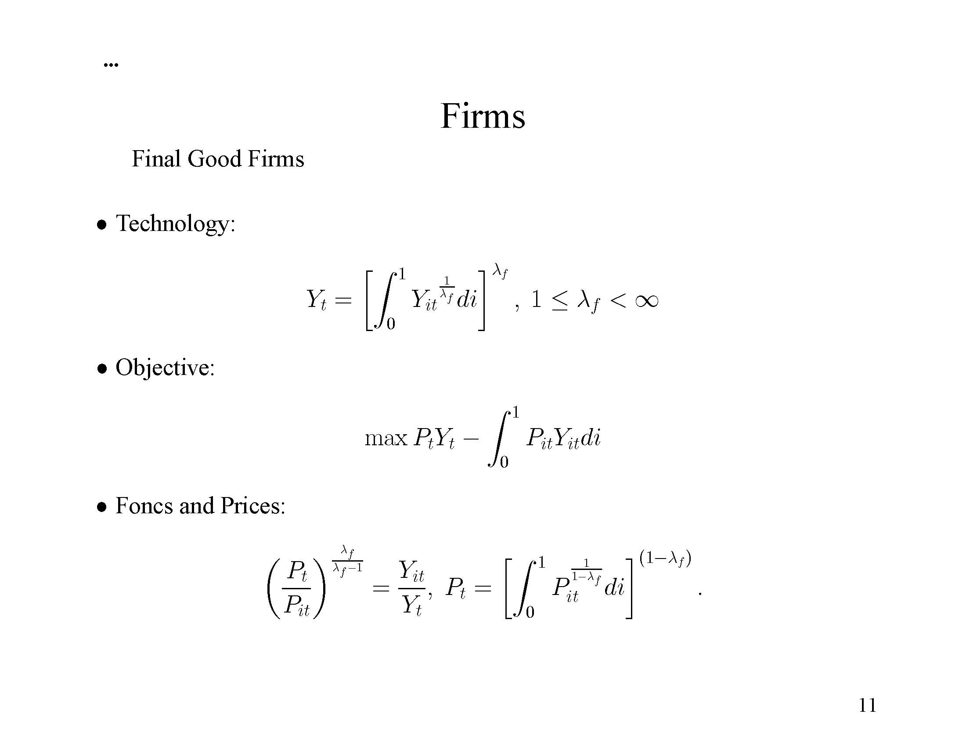
Notes:
Now, to the equations….

Slide 46
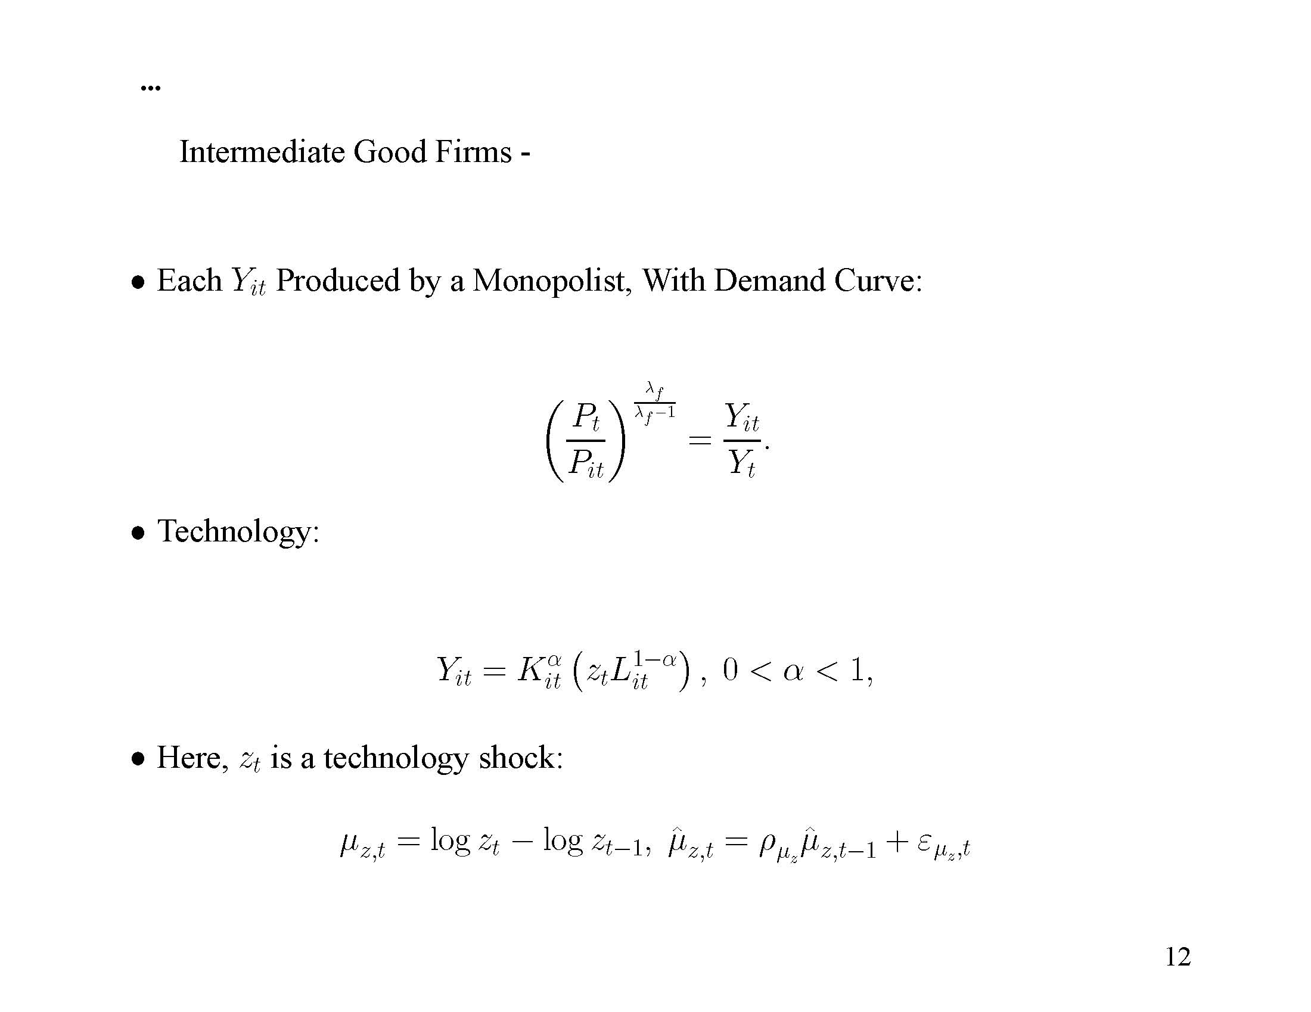
Notes:
Assumption about technology matches assumption made in SVAR identification.

Slide 47
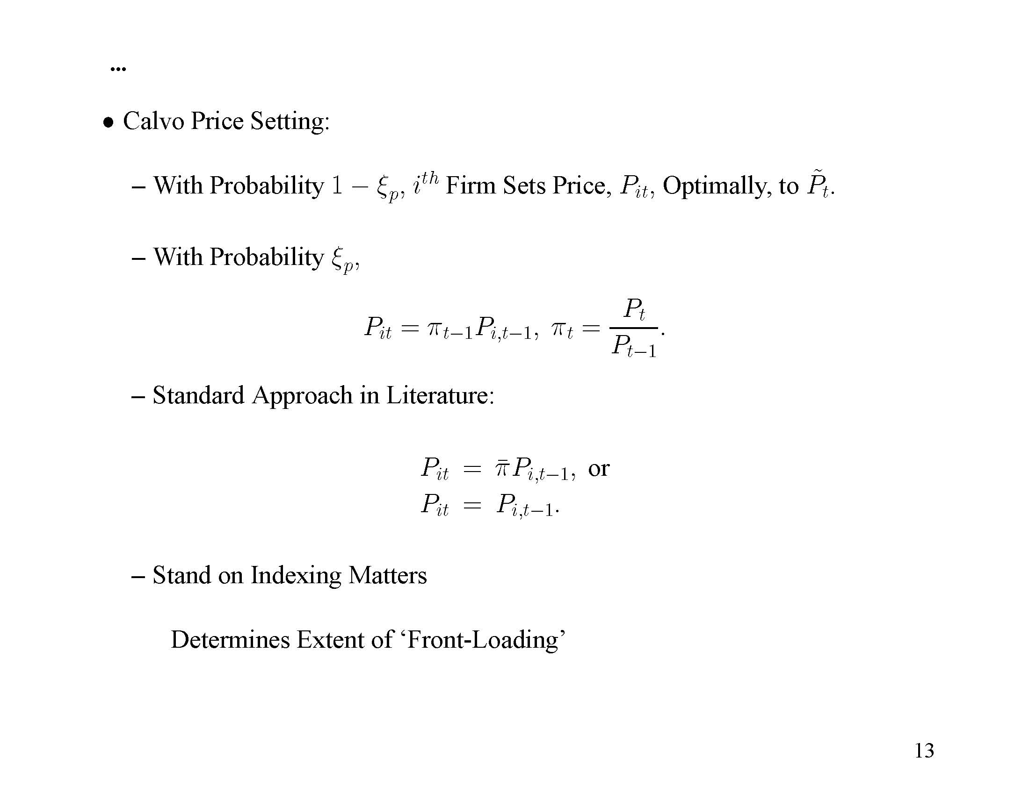

Slide 48
What Price Optimizers Do
What they do not do:
  Firms with the opportunity to set price today, do not do the usual thing of setting price as a markup of today’s marginal cost.
  This is because they understand there is a chance that they will be stuck in the future with the price they pick today.

Slide 49
What Price Optimizers Do, cont’d
Optimizers set price today based on expected current and future marginal costs.
Note:
  marginal cost involves interest rate, because firms are assumed to have to borrow to pay the wage bill.
  High supply elasticities limit rise in factor prices in an expansion and so limit the rise in marginal costs and, hence, prices.

Slide 50
Is Calvo a Good Reduced Form Model of Sticky Prices?
Evidence on relative frequency of large and small price changes suggests ‘yes’
Evidence of probability of price change conditional on time since last change suggests ‘yes’

Slide 51
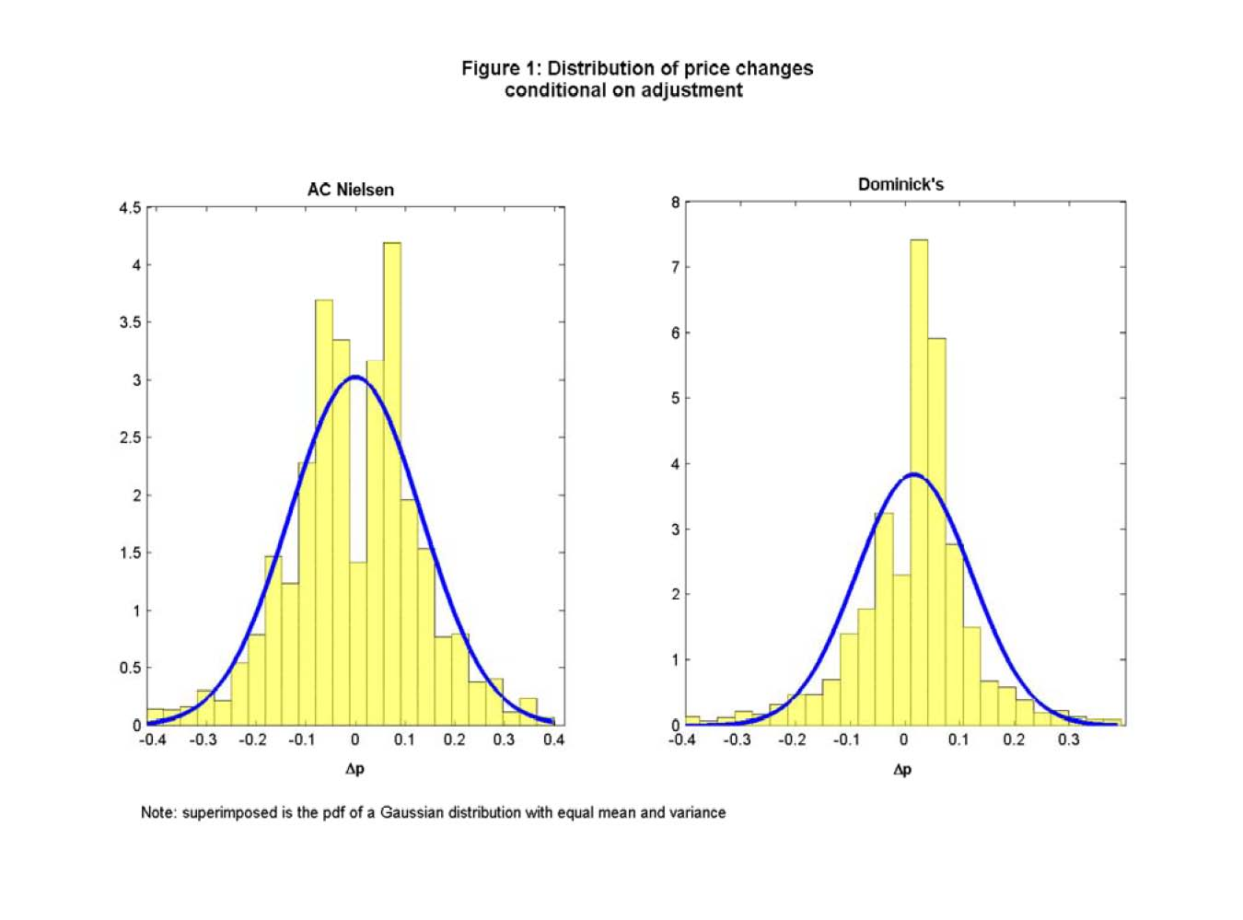
Evidence from Midrigan, ‘Menu Costs, Multi-Product Firms, and Aggregate Fluctuations’
Lot’s of
small
changes
Histograms of log(P_{t}/P_{t-1}), conditional on price adjustment, for two data sets
pooled across all goods/stores/months in sample.

Slide 52
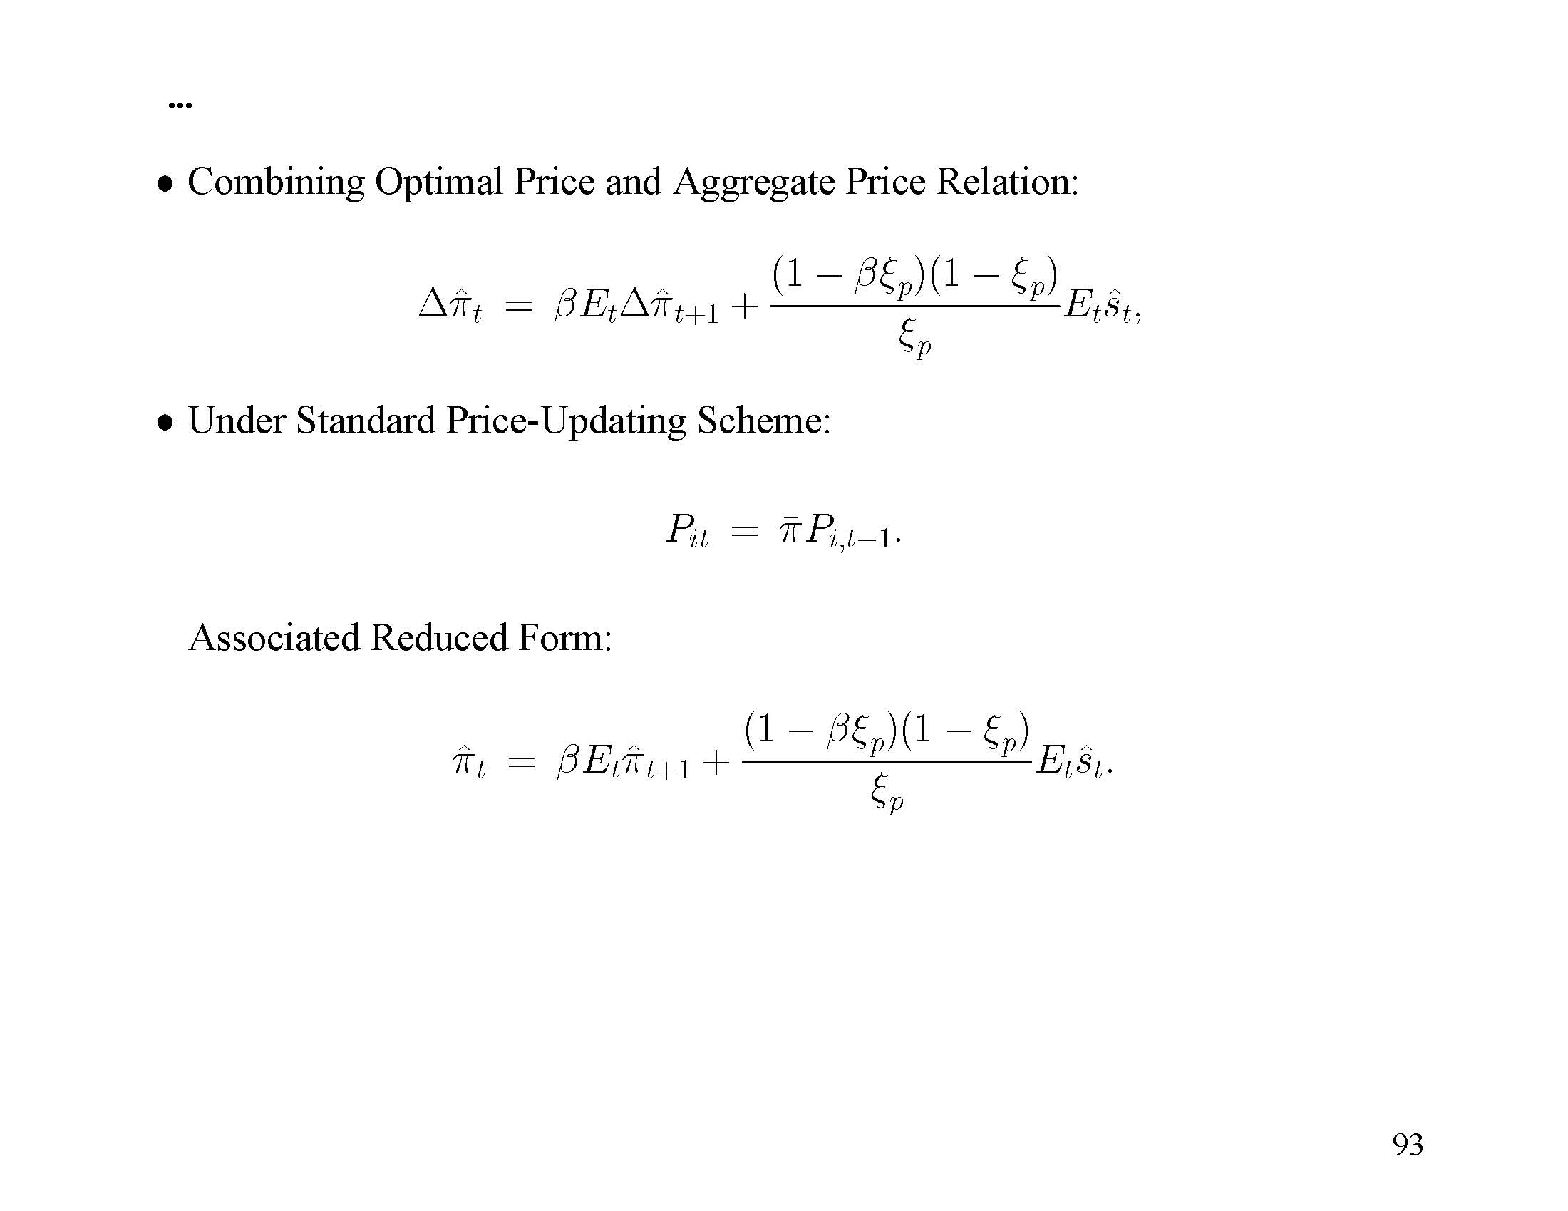

Slide 54
Households: Sequence of Events
Technology shock realized.
Decisions: Consumption, Capital accumulation, Capital Utilization.
Insurance markets on wage-setting open.
Wage rate set.
Monetary policy shock realized.
Household allocates beginning of period cash between deposits at financial intermediary and cash to be used in consumption transactions.
Notes:
The insurance markets are a technical device, whose purpose is to prevent monetary and other shocks from creating dispersion in wealth across economic agents. Handling that dispersion explicitly would make the analysis of the overall model computationally very burdensome, and we suspect the payoff would in any case be low. Dispersion in the distribution of income arising from idiosyncrasies in households’ ability to set wages would be very uninteresting from an economic point of view. Later, when we turn to financial frictions, we will discuss the distribution of income/wealth between different types of households (entrepreneurs and ordinary households) that has important aggregate consequences, and has a venerable tradition in economic thought.

Slide 55
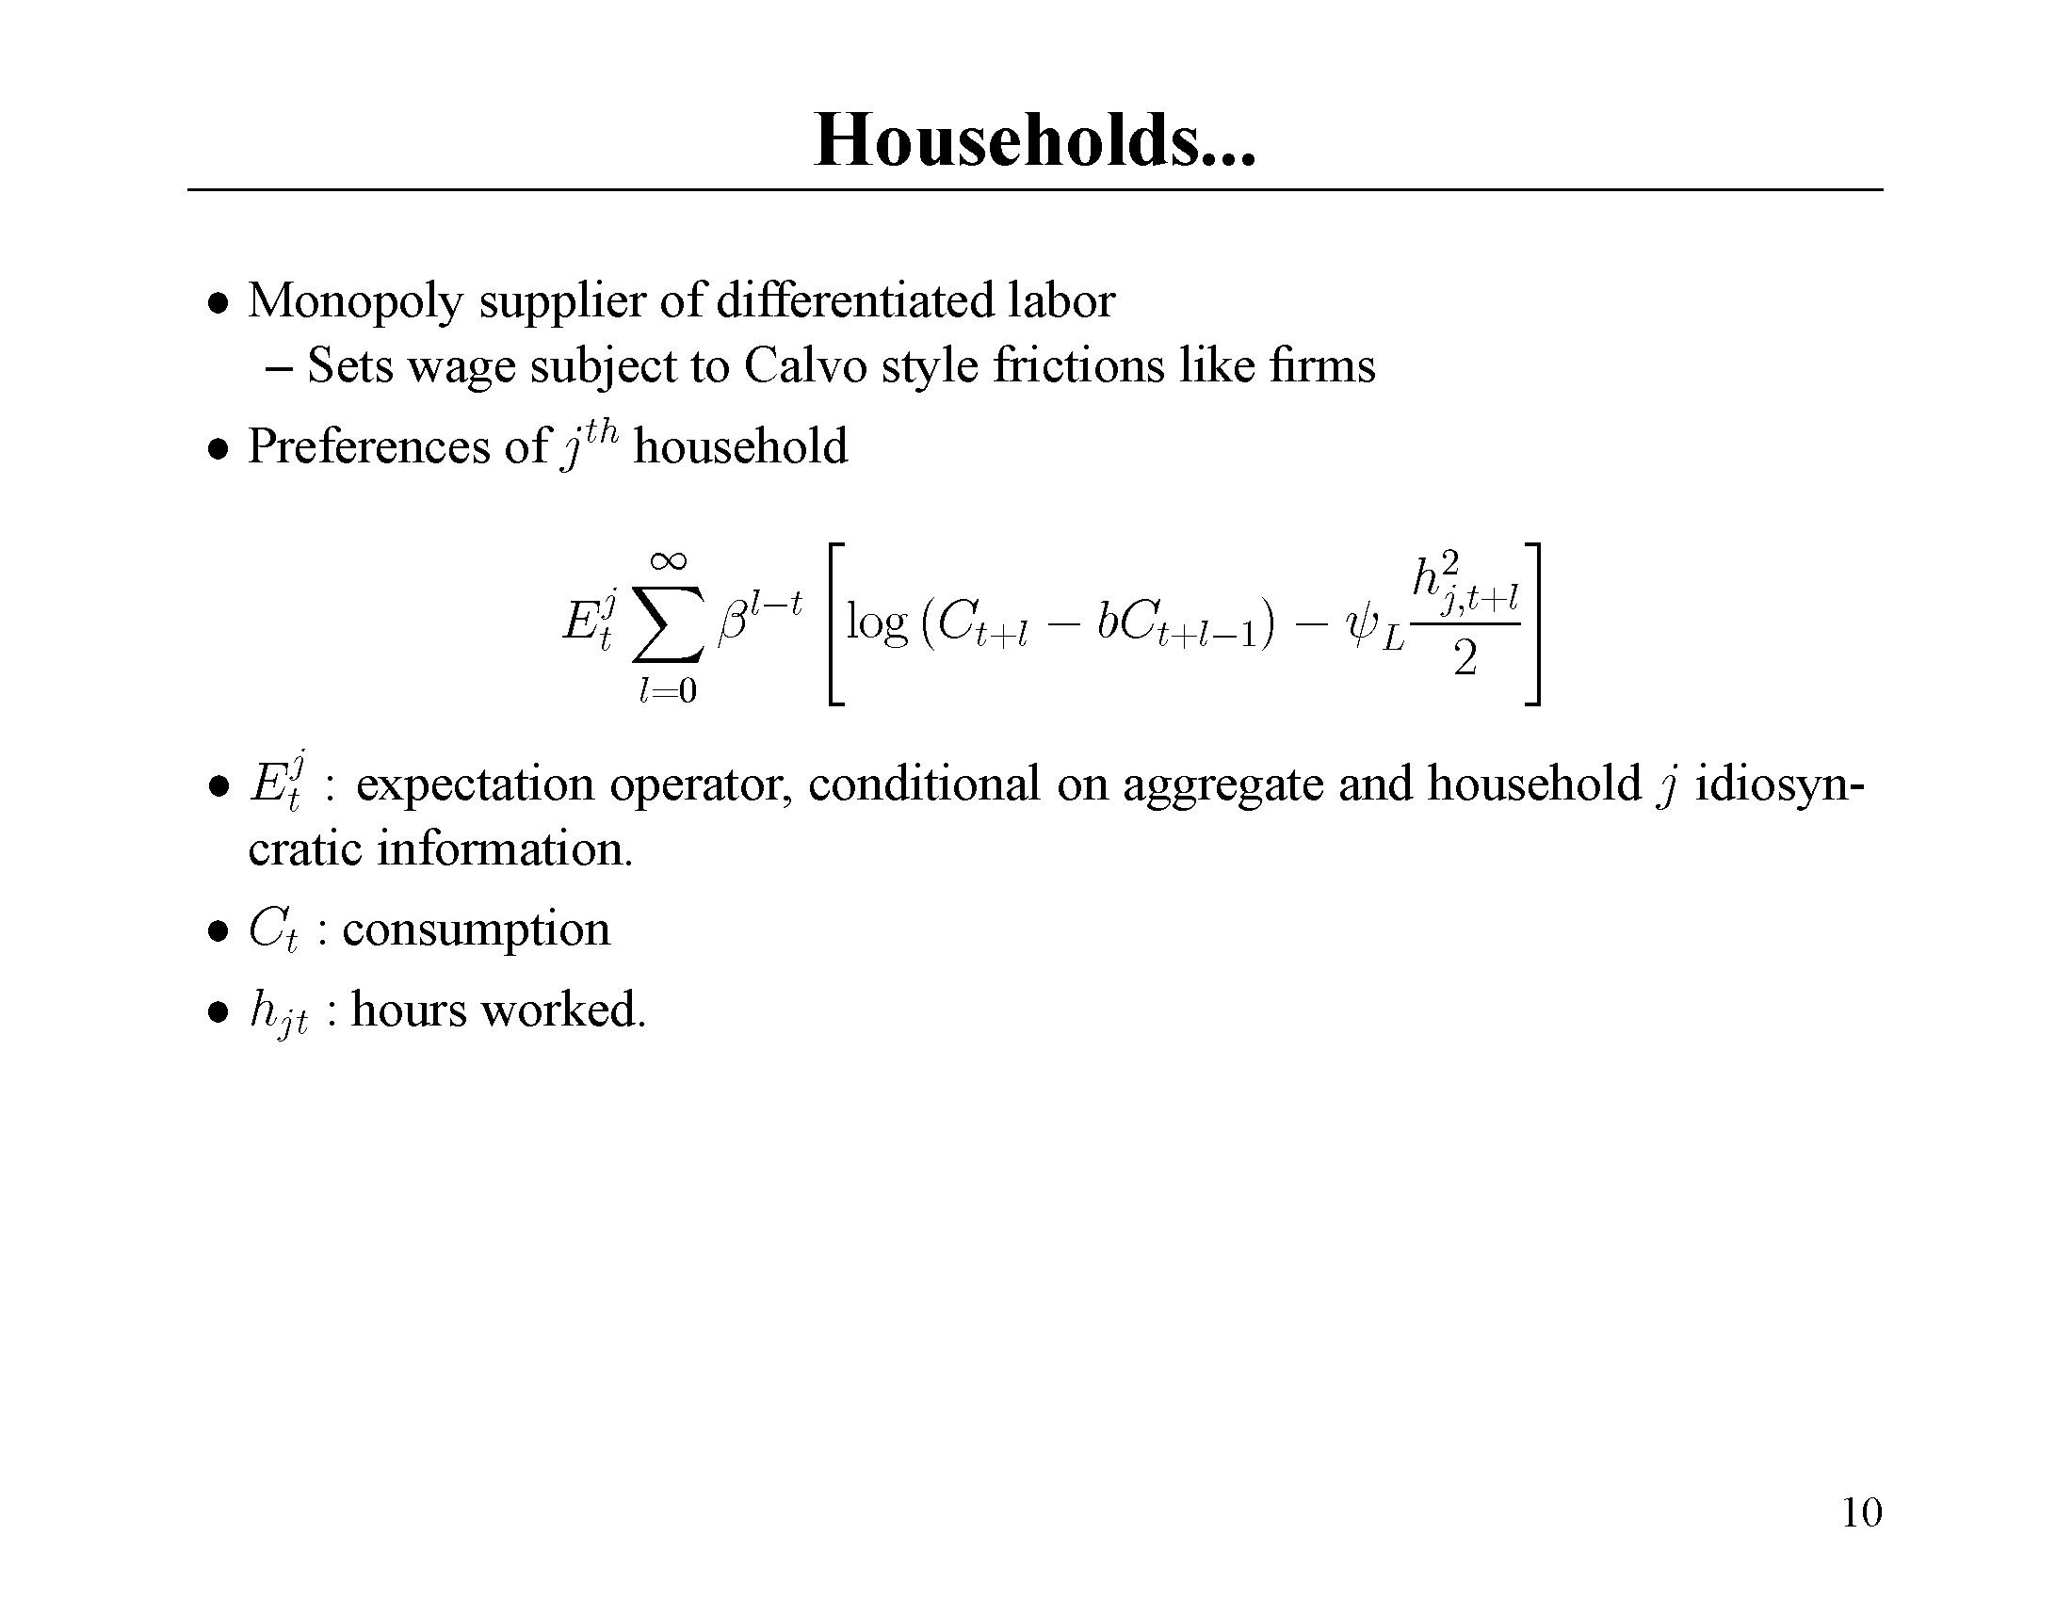

Slide 56
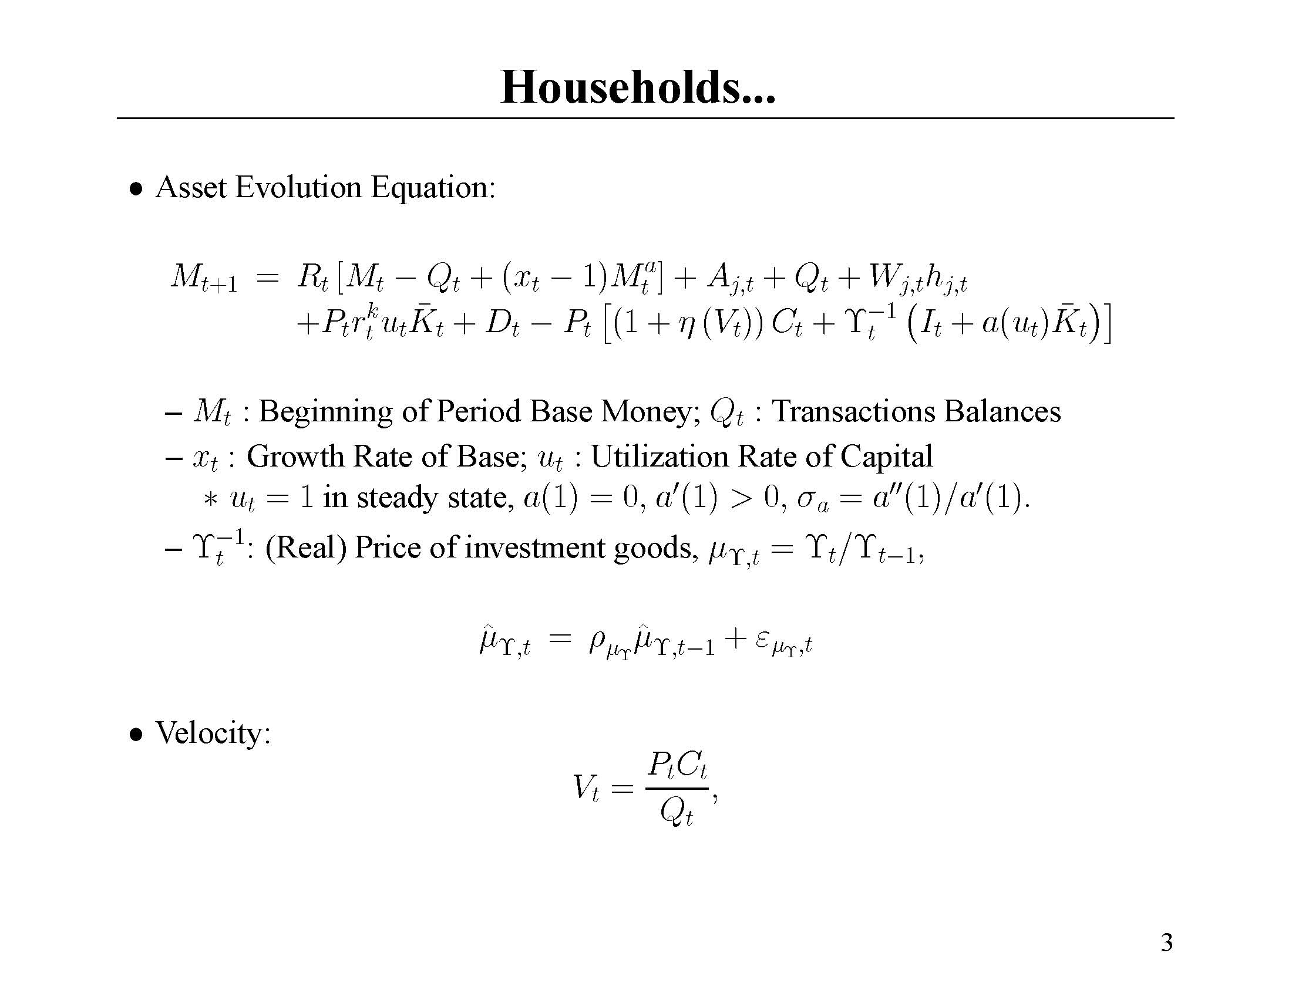
Notes:
In this budget constraint, we can see the usual trade-offs associated with money demand: when you hold more cash balances, Q, (i) you forgo interest income and (ii) you economize on transactions costs.

Slide 57
Notes:
Increasing utilization of capital brings in more revenues, in the form of rent, but raises costs as well. The costs are captured by the a() function, which is increasing and convex. The degree of convexity is captured by the parameter, sigma_a. The more convex, the more costs rise with increased utilization and the less they fall with decreased utilization. Thus, the bigger is sigma_a, the less utilization varies. When sigma_a is very large, then utilization is just constant. We leave it to the econometric estimation to pick sigma_a. A lower sigma_a allows firms to expand production in response to a monetary policy shock with relatively little increase in cost (because the supply of capital services can increase, limiting the natural upward pressure on the rental rate of capital that occurs in an expansion) and so therefore relatively little increase in price. The latter is important because of the evidence that inflation rises relatively little in response to a monetary policy shock.

Slide 59
Dynamic Response of Consumption to Monetary Policy Shock
In Estimated Impulse Responses:
  Real Interest Rate Falls
  Consumption Rises in Hump-Shape Pattern:
c
t

Slide 60
Consumption ‘Puzzle’
Intertemporal First Order Condition:
With Standard Preferences:
‘Standard’ Preferences
c
c
Data!
t
t

Slide 61
One Resolution to Consumption Puzzle
Concave Consumption Response Displays:
  Rising Consumption (problem)
  Falling Slope of Consumption
Habit Persistence in Consumption
  Marginal Utility Function of Slope of Consumption
  Hump-Shape Consumption Response Not a Puzzle
Econometric Estimation Strategy Given the Option, b>0
Habit parameter

Slide 62
Dynamic Response of Investment to Monetary Policy Shock
In Estimated Impulse Responses:
  Investment Rises in Hump-Shaped Pattern:
I
t

Slide 63
One Solution to Investment Puzzle…
Cost-of-Change Adjustment Costs:
This Does Produce a Hump-Shape Investment Response
  Other Evidence Favors This Specification
  Empirical: Matsuyama, Smets-Wouters.
  Theoretical: Matsuyama, David Lucca

Slide 64
Wage Decisions
Each household is a monopoly supplier of a specialized, differentiated labor service.
  Sets wages subject to Calvo frictions.
  Given specified wage, household must supply whatever quantity of labor is demanded.
Household differentiated labor service is aggregated into homogeneous labor by a competitive labor ‘contractor’.
Notes:
Each household’s labor effort is combined with all other households’ labor effort to produce aggregate ‘labor power’.

Slide 66
Labor supply
Nominal
wage, W
Shock
Firms use a lot of
Labor because it’s
‘cheap’.
Households must
supply that labor
Labor demand
Quantity of labor
Notes:
A rise in labor demand that comes, say, from an increase in demand for goods by final consumers, looks like it hits a perfectly elastic (flat) labor supply curve in the EHL model.

Slide 67
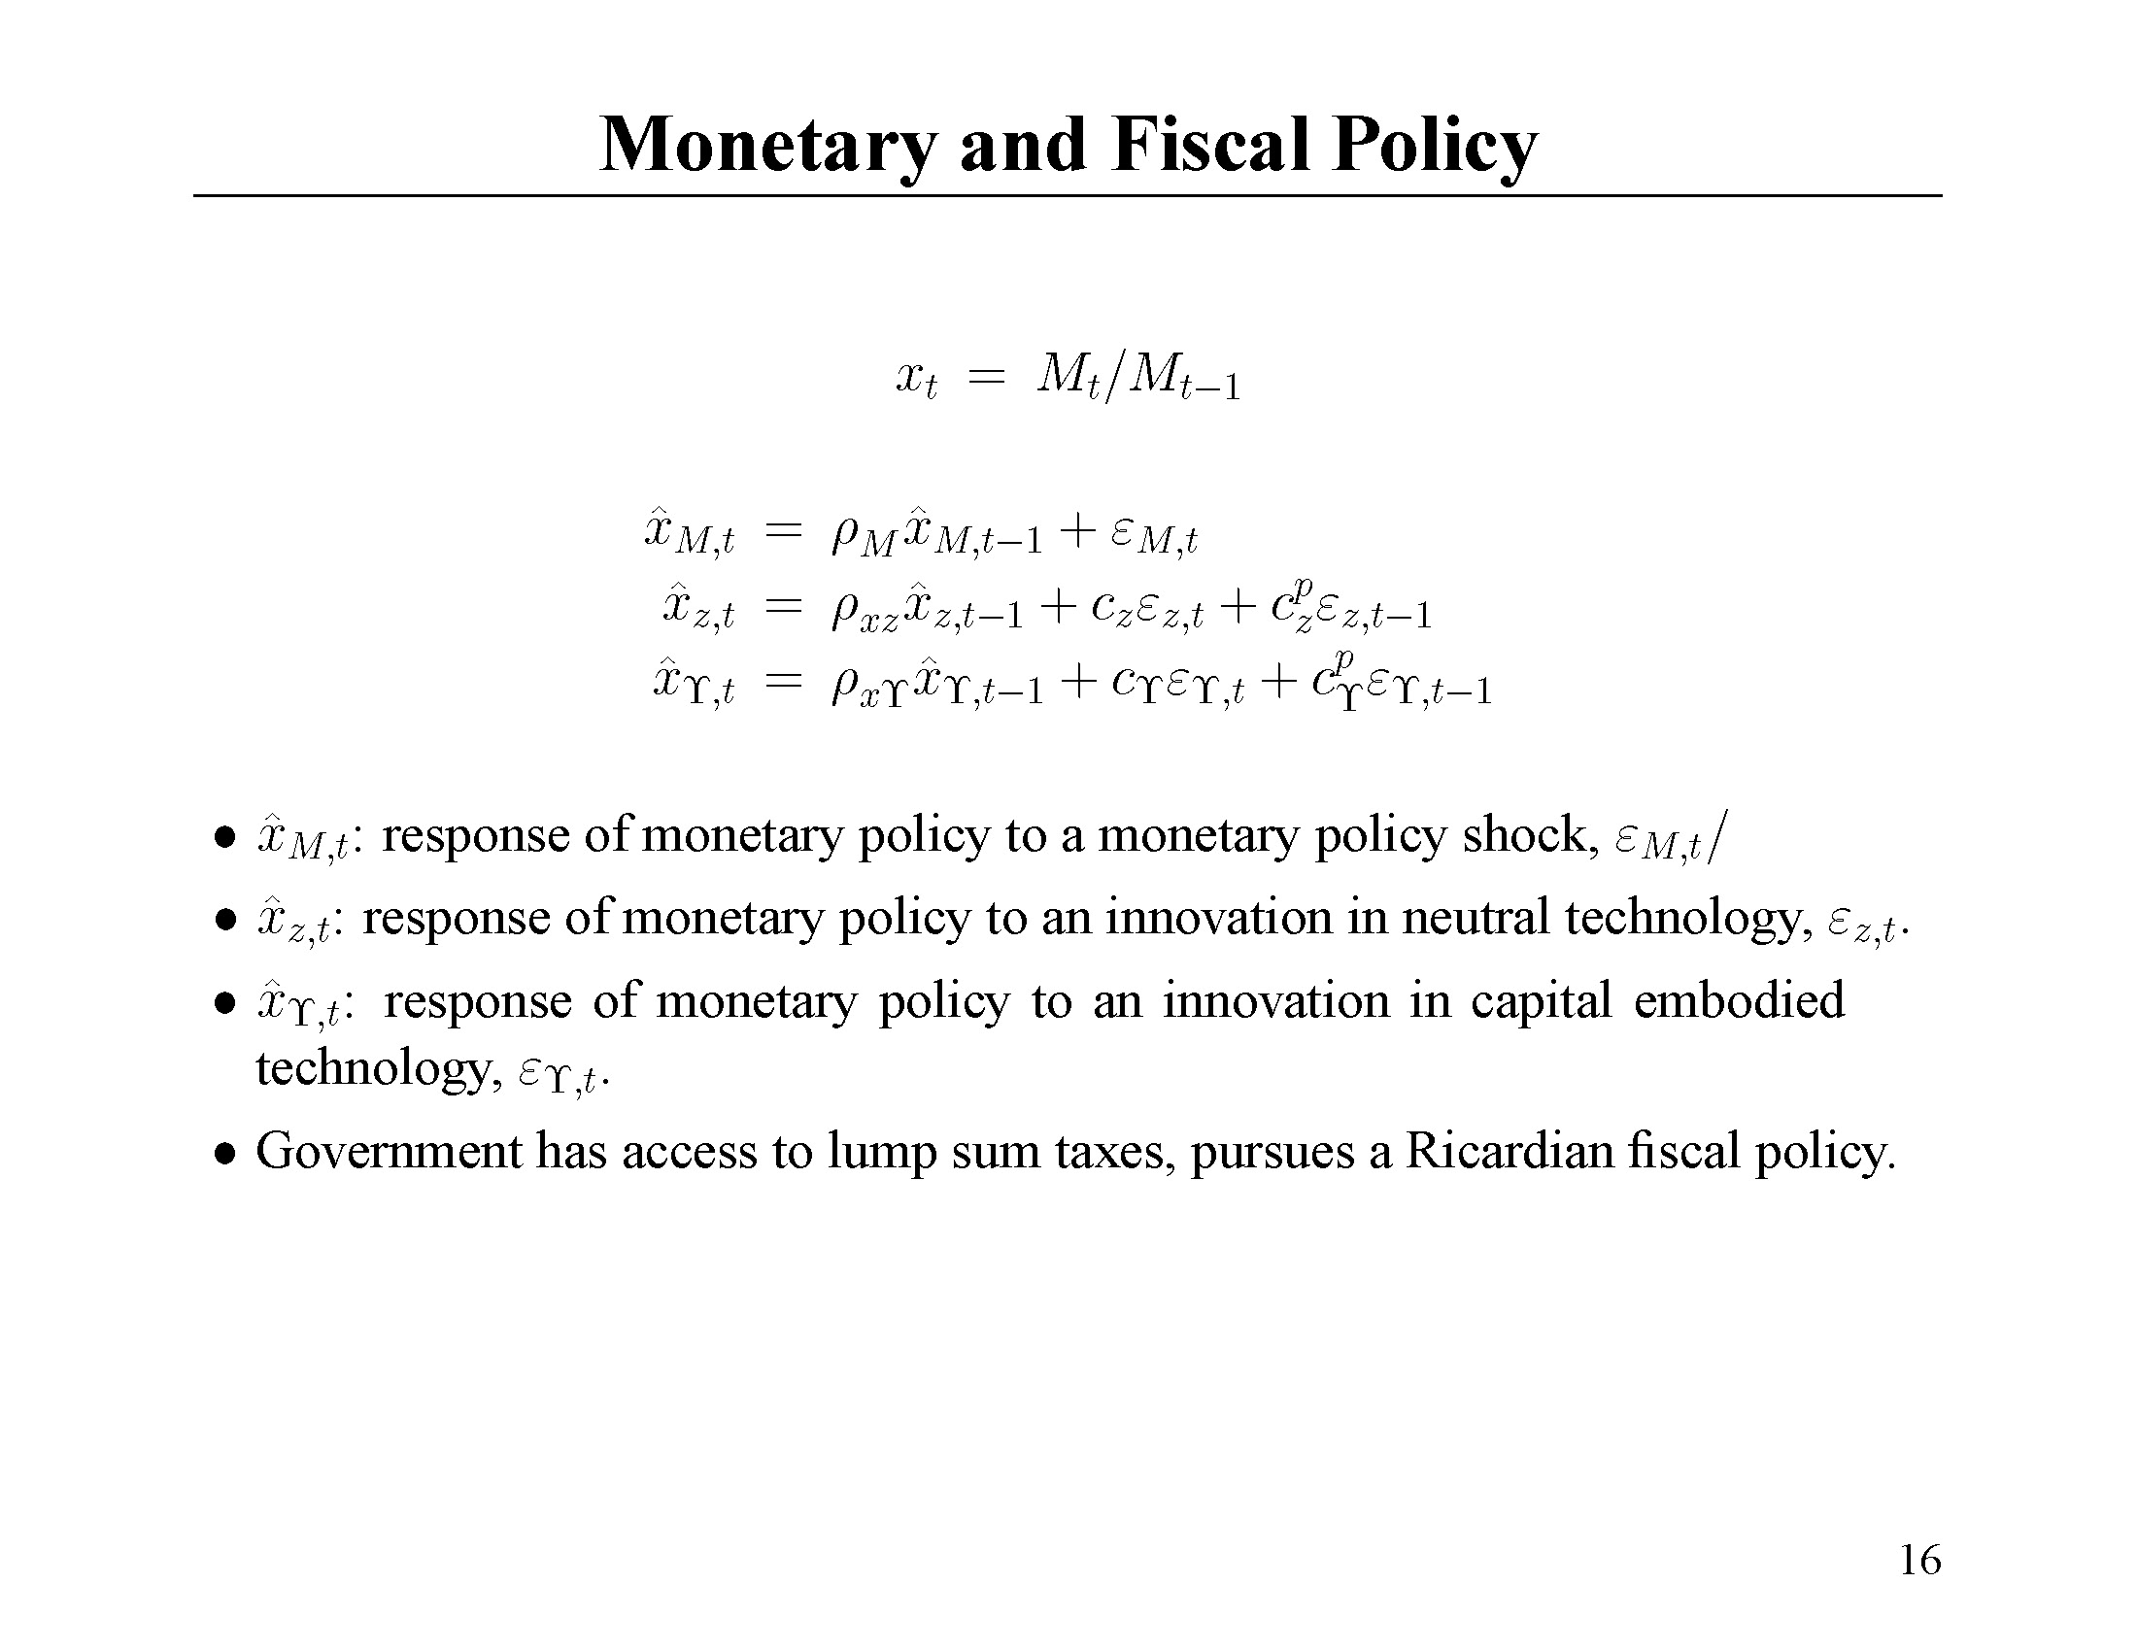

Slide 68
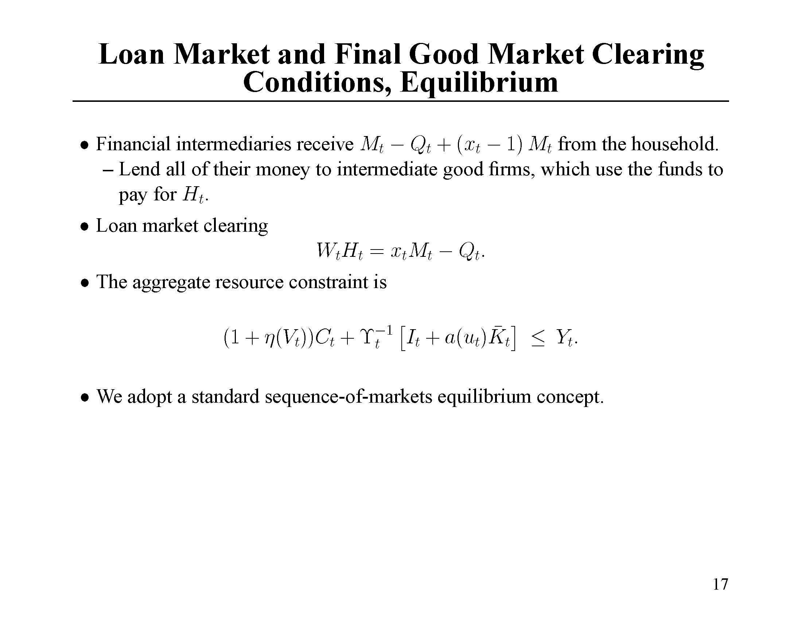

Slide 70
Econometric Methodology
Choose parameters of economic model, so that the dynamic response to shocks resembles as closely as possible the impulse responses estimated from SVARs.
Make sure that identifying assumptions used in the SVAR are satisfied in the model.

Slide 71
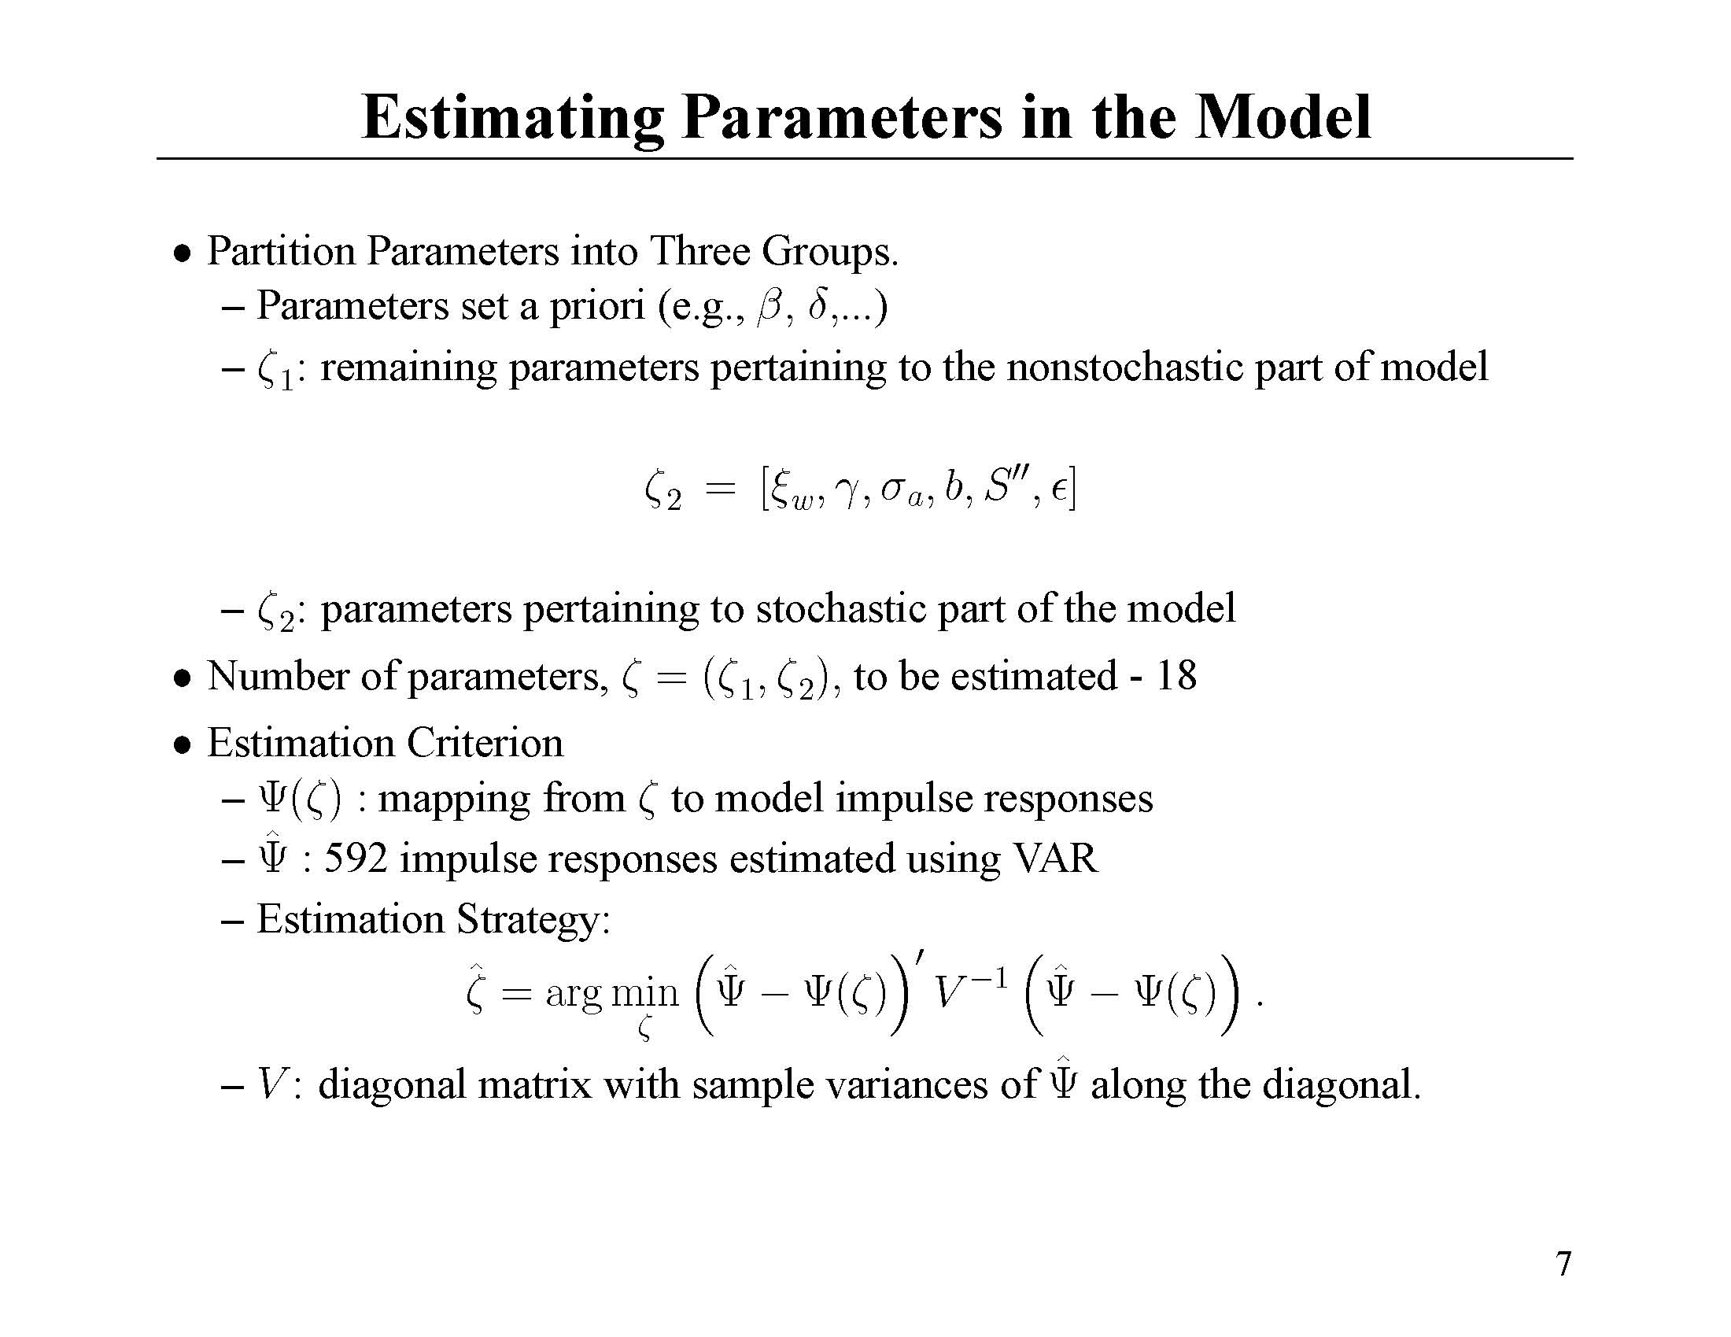

Slide 72
Parameter estimates
Parameters are surprisingly consistent with estimates reported in JPE (2005) based on studying only monetary policy shocks
Point estimates imply prices relatively flexible at micro level
  At point estimates:
Other parameters ‘reasonable’: estimation results really want sticky wages!

Slide 73
Notes:
Gamma in the box in the previous page is the slope of the Phillips curve, from which we can obtain xip

Slide 74
Parameters of exogenous shocks:
Neutral technology shock, ,is highly persistent.

Slide 75
Parameters of exogenous shocks:
Neutral technology shock, ,is highly persistent.

Slide 76
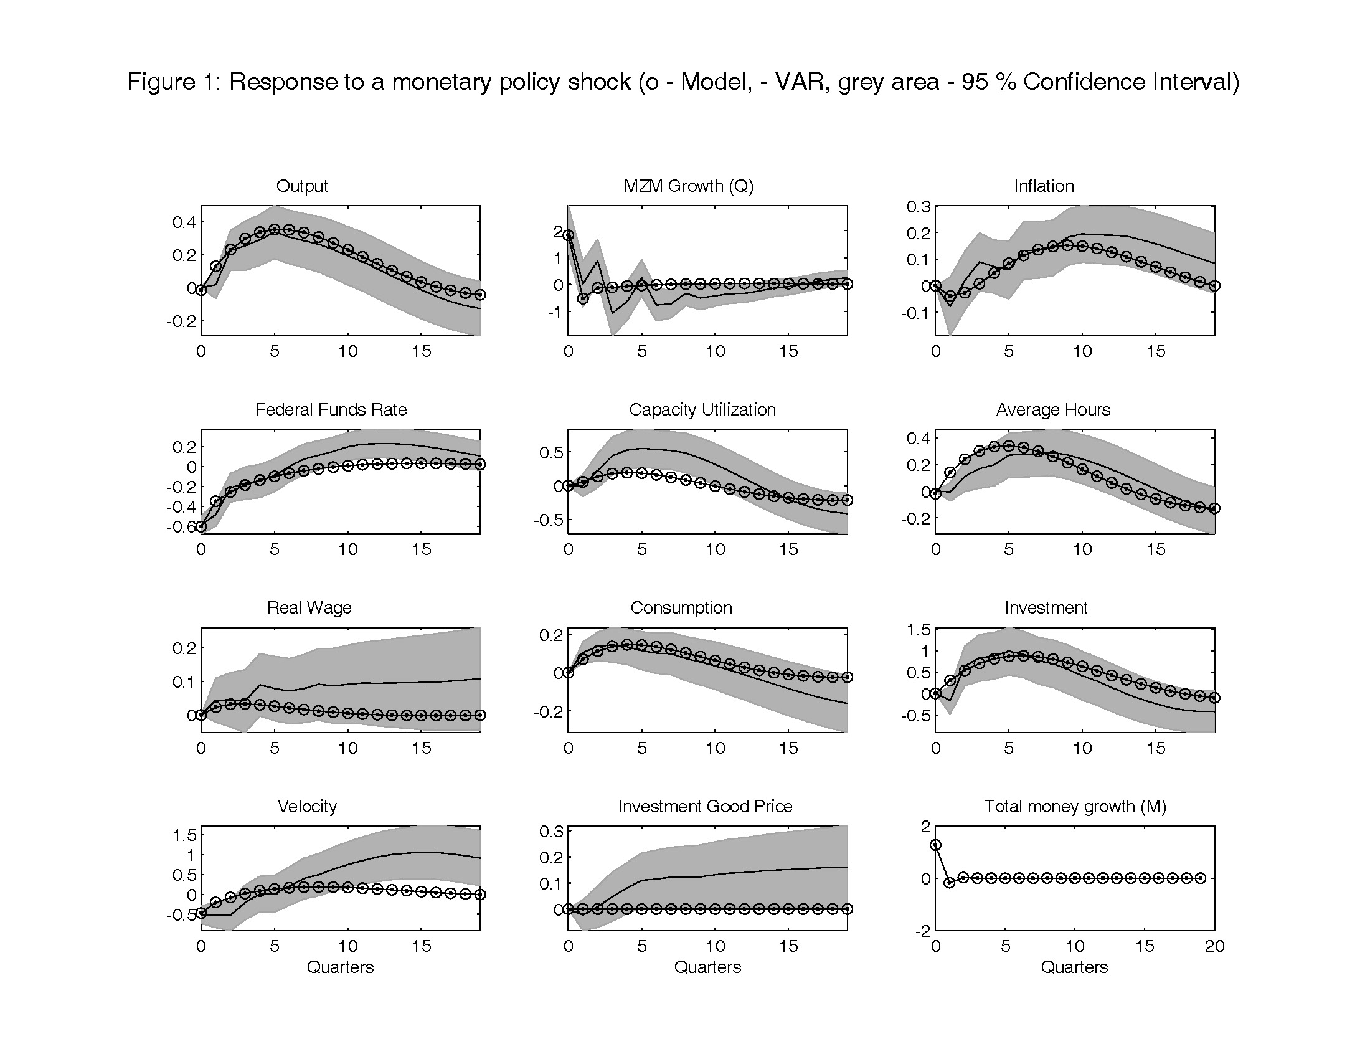

Slide 77
Monetary Policy Shock
Key findings:
  Can account for sluggish aggregate response to monetary policy shock without a lot of price stickiness
  Can account for the observed effects of monetary policy on consumption, investment, output, etc.

Slide 78
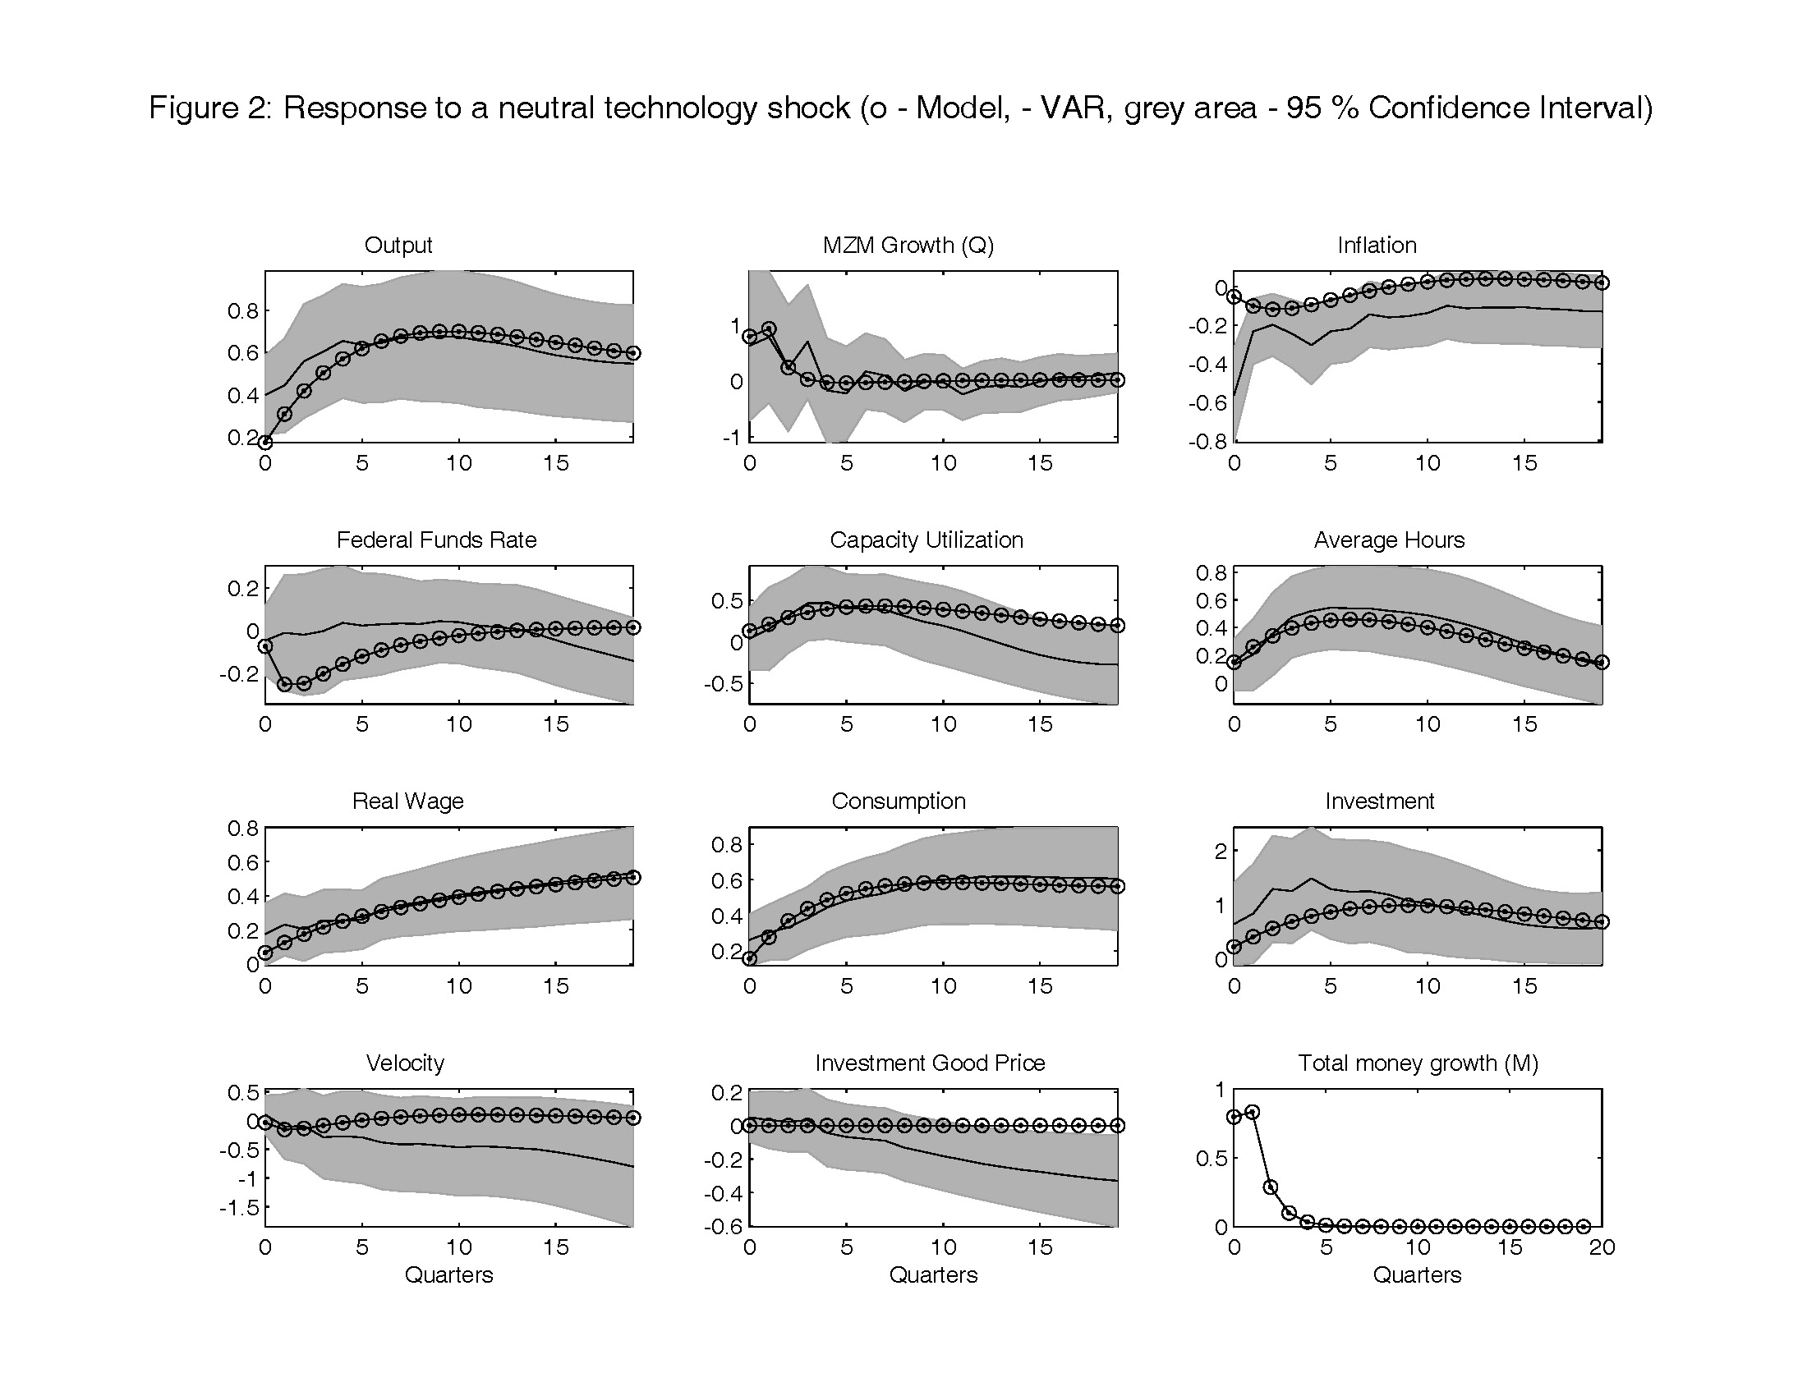

Slide 79
troublesome

Slide 80
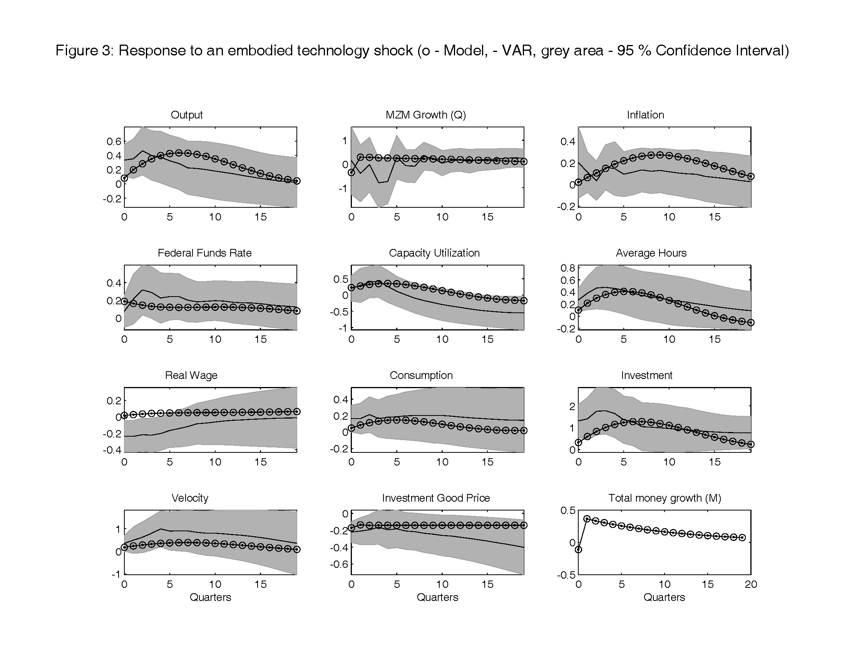

Slide 81
Further work with this model
Policy questions:
  role of monetary policy in transmission of technology shocks
  Role of monetary policy in asset price volatility
Can construct ‘micro panel data sets’ implied by model:
  Gain power to test model by developing its micro implications.
  What are cross-sectional implications of model for prices and quantities at the firm level?
Notes:
A lot of assumptions made about price stickiness, and would like to test those out more carefully, by bringing the model into closer contact with micro data.

Slide 82
Implications for Panel Data
‘Demand shocks’ for intermediate good firms:
‘Supply shocks’ for intermediate good firms:

Slide 83
Conclusion of ‘Consensus’ Model Construction and Estimation
Identified features of a model (variable capital utilization, habit persistence, adjustment costs in the change of investment) that allow it to account for estimated SVAR impulse responses.
The estimation strategy focused on a subset of model implications.
Full information methods have been used to estimate version of the model with a full set of shocks on the raw data (Smets and Wouters).
A future phase of empirical work will draw out the implications of macro models for panel data sets.

Slide 84
Additional model development
Labor market
  Model has no implications for unemployment, vacancies, hours worked, people employed, separations, on-the-job search, etc.
  Sticky wages in model subject to ‘Barro critique of sticky wages’
Financial markets
  Financial markets are not a source of shocks or propagation.
  Cannot ask: ‘what should monetary authority do in response to increase in interest rate spreads?’

Slide 85
‘Barro critique’
Most worker-firm relationships are long-term, and unlikely to be strongly affected by details of the timing of wage-setting.
Standard sticky wage model implausible.
Recent results in search-matching literature:
  Must distinguish between intensive (hours) and extensive (employment) margin.
  Barro critique applies to idea that wage frictions matter in the intensive margin.
  Does not apply to idea that wage frictions matter for extensive margin.

Slide 86
Papers
Mortensen and Pissarides
Shimer
Gertler-Trigari, Gertler-Sala-Trigari
Hall
Den Haan, Ramey and Watson
Christiano, Ilut, Motto, Rostagno
Christiano, Trabandt, Walentin

Slide 88
Adding Labor Market Frictions
Employment agency
Firms
Labor Market
Employment agency
Undirected search
endogenous vacancies
Households
Employment agency
Unemployment
Endogenous
and exogenous separation

Slide 89
More on the Labor Market
Number of employed
workers in cohort i
Household Preferences
Worker finances
hours per worker in cohort i

Slide 90
Timeline – labor market
Stock of employees in
each agency reduced by
exogenous separations
increased by new arrivals
Each worker experiences idiosyncratic, iid
productivity shock. Least efficient are cut:
Unilateral firm decision
Cut determined by total surplus criterion
Vacancies posted
Agency employees
sent to work
Shocks
realized
t
t+1
Wages set
If it’s a time to bargain, choose wage to solve
Otherwise, do simple updating
Hours worked set according to
an efficiency criterion:
Marginal value of worker to
agency = marginal cost of
labor for worker

Slide 91
Timeline – labor market
Each worker experiences idiosyncratic, iid
productivity shock. Least efficient are cut:
Unilateral firm decision
Cut determined by total surplus criterion
Bargaining internalizes nature of the job
t
t+1
Wages set
If it’s a time to bargain, choose wage to solve
Otherwise, do simple updating
Hours worked set according to
an efficiency criterion:
Marginal value of worker to
agency = marginal cost of
labor for worker

Slide 92
Extension to Incorporate Financial Frictions
General idea:
  Standard model assumes borrowers and lenders are the same people..no conflict of interest
  Financial friction models suppose borrowers and lenders are different people, with conflicting interests
  Financial frictions: features of the relationship between borrowers and lenders adopted to mitigate conflict of interest.

Slide 93
Standard Model
Firms
consumption
Investment goods
Rent capital
Supply labor
Households
Notes:
In the standard model, firms produce output, which is sold to households in the form of investment and consumption goods. The firms produce using labor and capital, which is rented to them by households. It’s from there that households get the income needed to buy the investment and consumption goods. What’s special about the standard model is the treatment of capital. The physical capital is produced in people’s backyard. What this means is that savers and investors are the same people.

Slide 94
Frictions in Financing of Physical Capital
Money
Savers
Have money, but no ideas
Investors
(‘entrepreneurs’)
Have ideas, but not enough money.

Slide 95
Frictions in Financing of Physical Capital
Money
Savers
Have money, but no ideas
Investors
(‘entrepreneurs’)
Problem: ‘stuff’ happens.
Incentive of entrepreneurs to under-report earnings

Slide 96
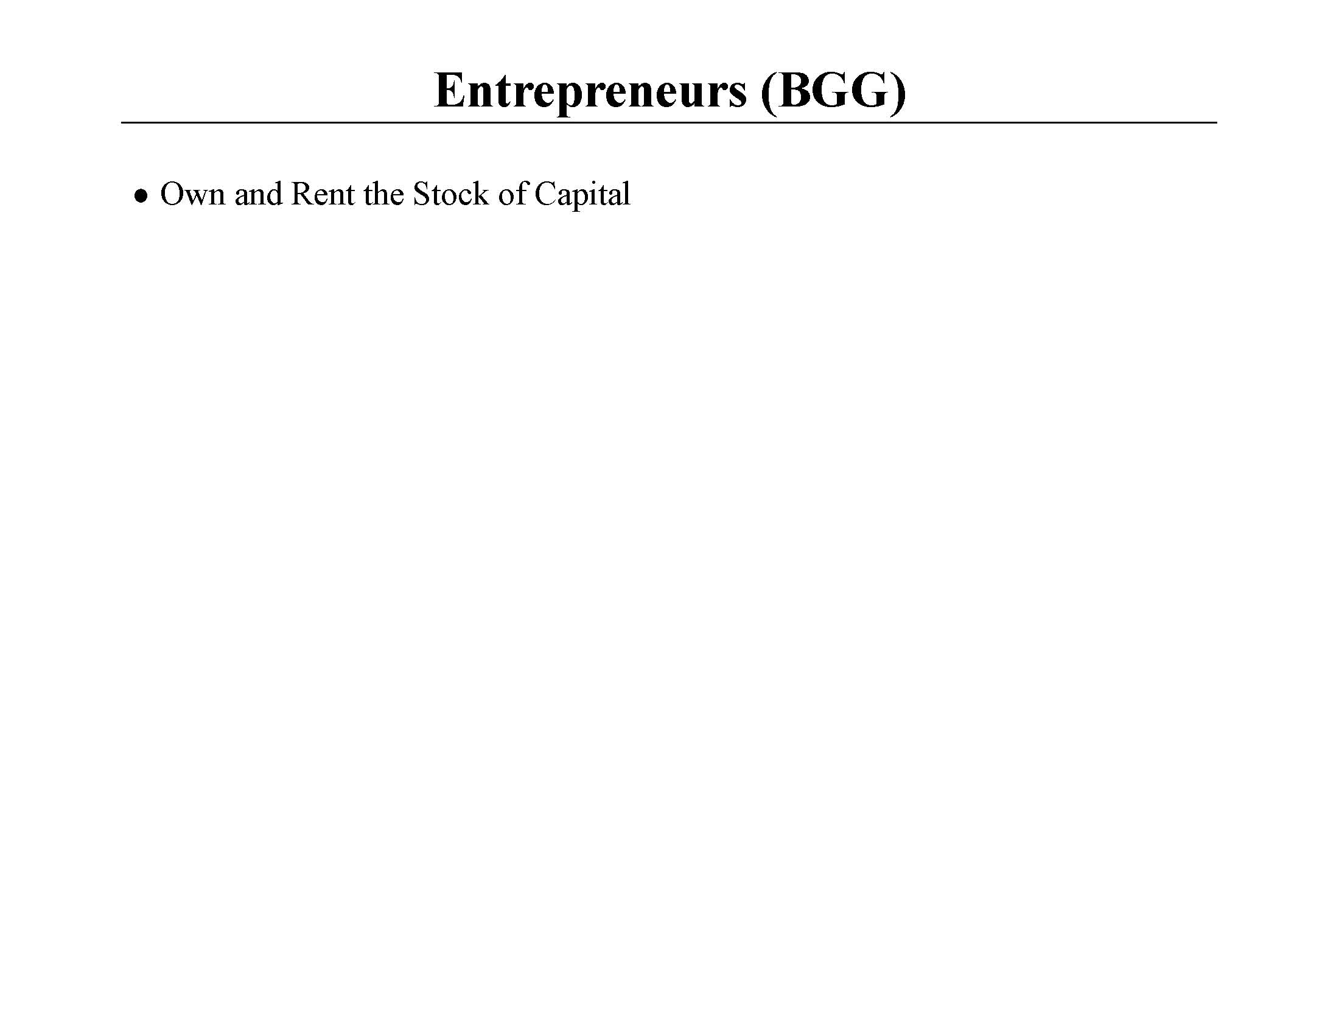

Slide 97
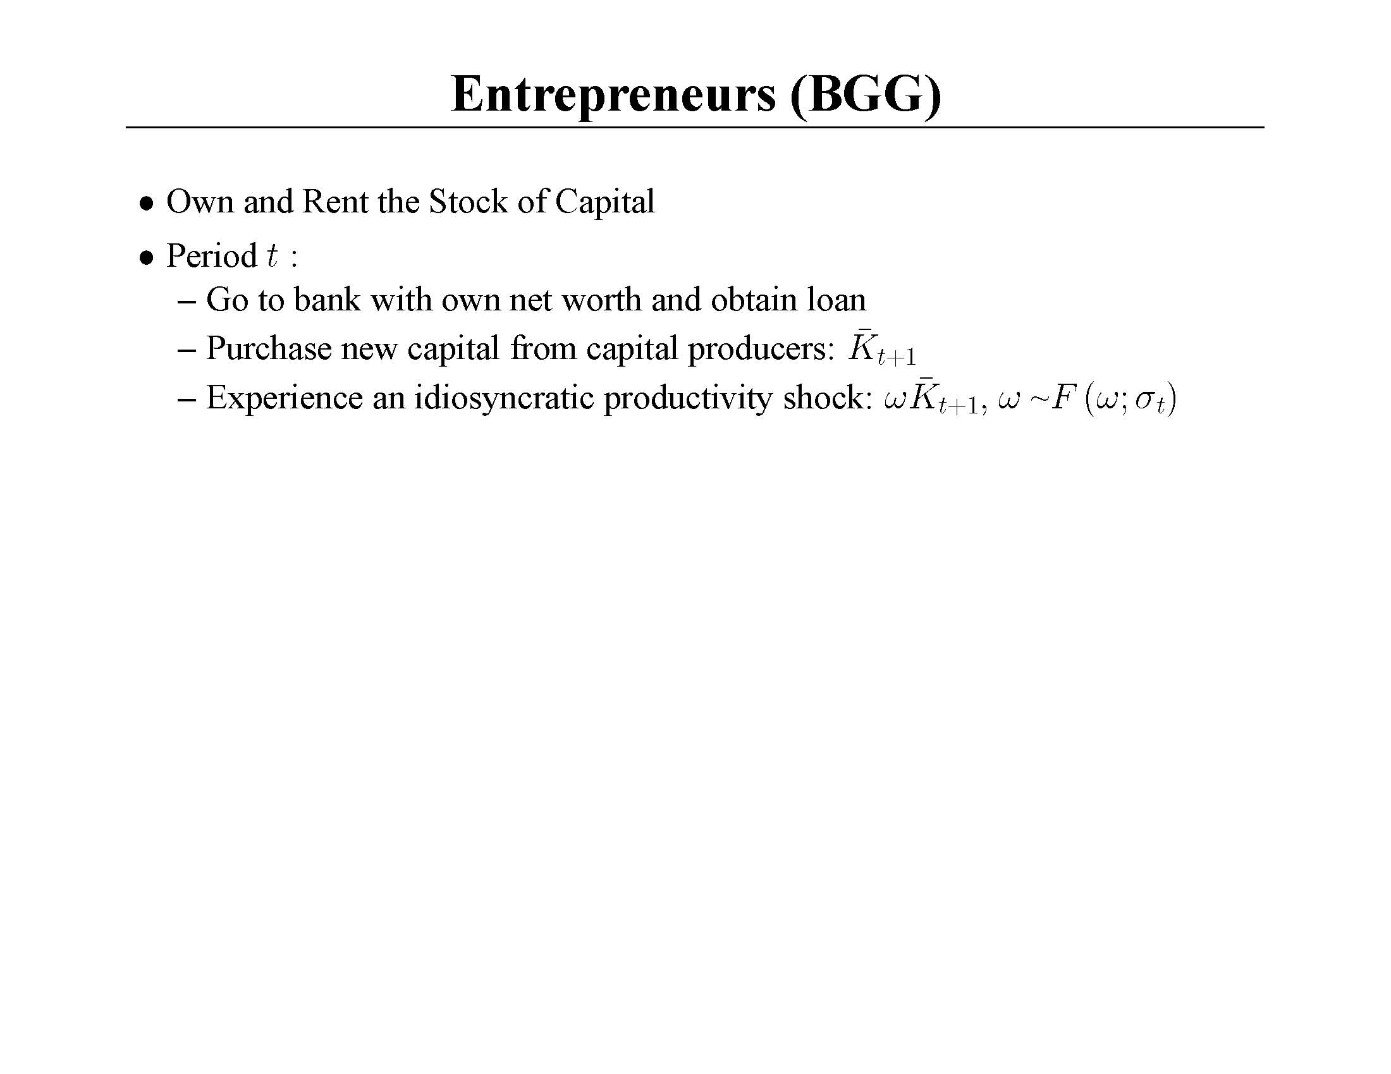
Notes:
Entrepreneurs have a special ability to squeeze services out of capital. They have their own resources, or net worth. It is profitable for them to leverage their own resources to get bank loans and operate more capital than their own resources permit. So, they go to banks to get loans. The problem is that there is idiosyncratic uncertainty about the projects entrepreneurs undertake, and there is private information about this uncertainty. This creates a conflict between borrowers and lenders which is assumed to be resolved by setting up a standard debt contract between entrepreneurs and the bank. We allow the idiosyncratic uncertainty to be a shock. In the model, when sigma jumps, the bankruptcy rate jumps, external finance premium jumps, price of capital drops, net worth fall, etc.

Slide 98
Notes:
Entrepreneurs have a special ability to squeeze services out of capital. They have their own resources, or net worth. It is profitable for them to leverage their own resources to get bank loans and operate more capital than their own resources permit. So, they go to banks to get loans. The problem is that there is idiosyncratic uncertainty about the projects entrepreneurs undertake, and there is private information about this uncertainty. This creates a conflict between borrowers and lenders which is assumed to be resolved by setting up a standard debt contract between entrepreneurs and the bank. We allow the idiosyncratic uncertainty to be a shock. In the model, when sigma jumps, the bankruptcy rate jumps, external finance premium jumps, price of capital drops, net worth fall, etc.

Slide 99
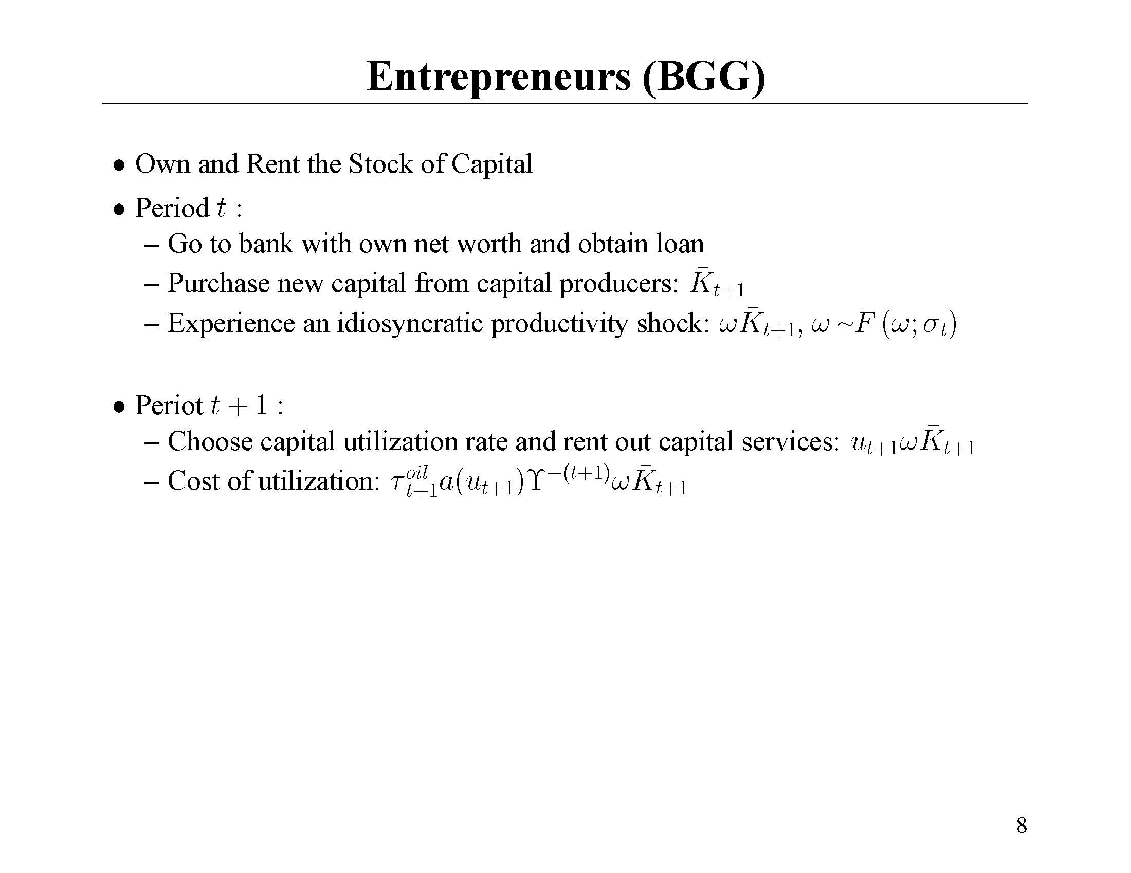
Notes:
Here there is a new shock, tauoil. We associate this with the price of oil, which we think of as affecting the cost of utilizing capital.

Slide 100
Notes:
Here there is a new shock, tauoil. We associate this with the price of oil, which we think of as affecting the cost of utilizing capital.

Slide 101
Source of accelerator effects
Notes:
Here there is a new shock, tauoil. We associate this with the price of oil, which we think of as affecting the cost of utilizing capital.

Slide 102
Source of Fisher deflation effect
Notes:
Here there is a new shock, tauoil. We associate this with the price of oil, which we think of as affecting the cost of utilizing capital.

Slide 103
Notes:
Here there is a new shock, tauoil. We associate this with the price of oil, which we think of as affecting the cost of utilizing capital.

Slide 104
Prediction of financial friction model:
Shocks that drive output and price in the same direction (‘demand’) accelerated by financial frictions.
  Fisher and earnings effects reinforce each other.
Shocks that drive output and price in opposite directions (‘supply’) not much affected by financial frictions.
  Fisher and earnings effects cancel each other.

Slide 105
Model with Financial Frictions
Firms
L
K
Labor market
I
Entrepreneurs
C
Capital Producers
household

Slide 106
Model with Financial Frictions
Firms
Labor market
Entrepreneurs
Capital Producers
K’
household
banks
Loans

Slide 107
The equations of the financial friction model
Net addition of two equations to consensus model:
  Subtract the household intertemporal equation for capital.
  Add three equations pertaining to the entrepreneurs

Slide 108
Three equations pertaining to entrepreneur
Law of motion of net worth
Zero-profit conditions of banks
Optimality condition associated with entrepreneur’s choice of contract.

Slide 109
Empirical Analysis of Financial Friction Model
Christiano-Motto-Rostagno (2008), based on Bernanke-Gertler-Gilchrist (1999) model of financial frictions.

Slide 110
Risk Shock and News
Assume
Agents have advance information about pieces of

Slide 111
Estimation
EA and US data covering 1985Q1-2007Q2
Standard Bayesian methods
We remove sample means from data and set steady state of X to zero in estimation.
Notes:
For EA, we drop bank reserves and the bank shock to the demand for reserves.

Slide 112
Summary of Empirical Results With Financial Frictions
Risk shocks:
  important source of fluctuations.
  news on the risk shock important
The Fisher debt-deflation channel has a substantial impact on propagation.
Money demand and mechanism of producing inside money:
  relatively unimportant as a source of shocks
  modest contribution to forecast ability
Model accounts or substantial fraction of fluctuations in term structure.
Out-of-Sample RMSEs of the model perform well compared with BVAR and simpler models.

Slide 113
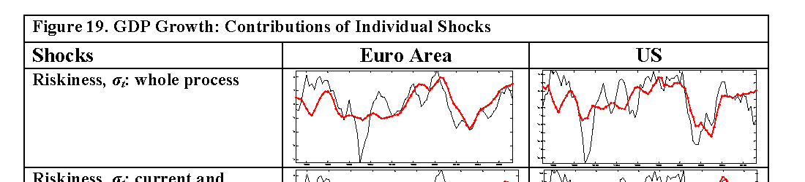
Risk Shocks are Important
Actual data versus what actual data would have been if there were only risk
Shocks:
Note:
(1) as suggested by the picture, risk shocks are relatively
important at the lower frequencies
(2) We find that they are the single most important source of low frequency
fluctuation in the EA, and a close second (after permanent tech shocks) in the US

Slide 114
Risk Shocks are Important
Actual data versus what actual data would have been if there were only risk
Shocks:
Note:
(1) as suggested by the picture, risk shocks are relatively
important at the lower frequencies
(2) We find that they are the single most important source of low frequency
fluctuation in the EA, and a close second (after permanent tech shocks) in the US

Slide 115
Markup
Banking tech
Capital tech
Money demand
Government
Permanent tech
Gamma shock
Temporary tech
Monetary policy
Risk, contemp
Signals on risk
Risk and signals
Discount rate
Marginal eff of I
Price of oil
Long rate error
Notes:
Markup uncomfortably important for inflation
Banking, money demand has small effect.
Monetary policy is small.

Slide 116
It’s the
signals!

Slide 117
Markup
Banking tech
Capital tech
Money demand
Government
Permanent tech
Gamma shock
Temporary tech
Monetary policy
Risk, contemp
Signals on risk
Risk and signals
Discount rate
Marginal eff of I
Price of oil
Error in long rate

Slide 118
Markup
Banking tech
Capital tech
Money demand
Government
Permanent tech
Gamma shock
Temporary tech
Monetary policy
Risk, contemp
Signals on risk
Risk and signals
Discount rate
Marginal eff of I
Price of oil
Error in long rate
Signal matters!

Slide 119
Importance of Risk Signals

Slide 120
Why is Risk Shock so Important?
According to the model, external finance premium is primarily risk shock.
To look for evidence that risk might be important, look at dynamics of external finance premium and gdp.
External finance premium is a negative leading indicator

Slide 121
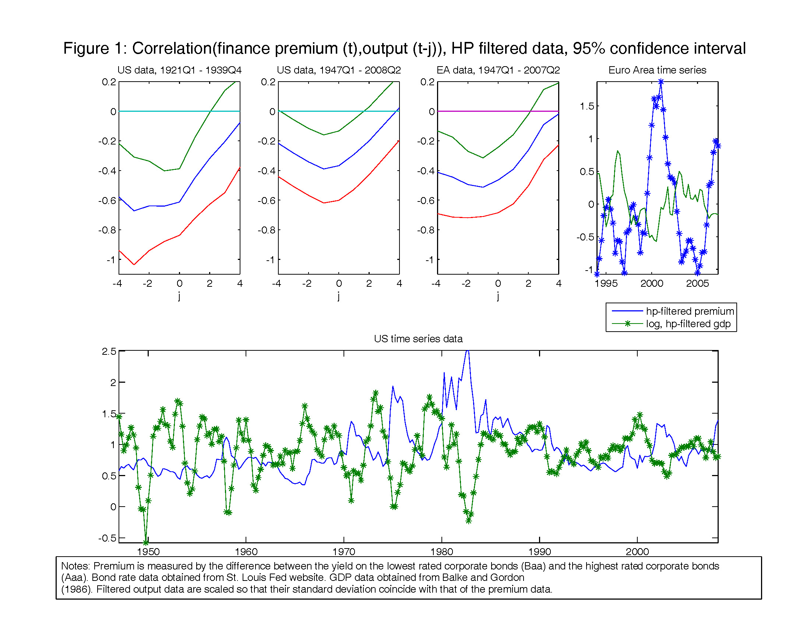

Slide 125
Why is Risk Shock so Important?:
A second reason
Our data set includes the stock market
  Output, stock market, investment all procyclical (surge together in late 1990s)
  This is predicted by risk shock.

Slide 126
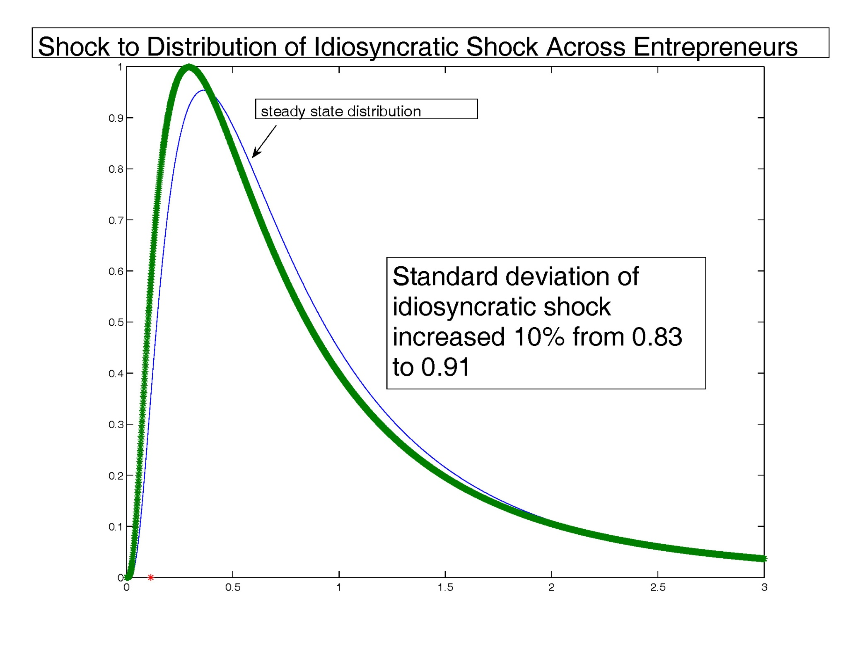

Slide 127
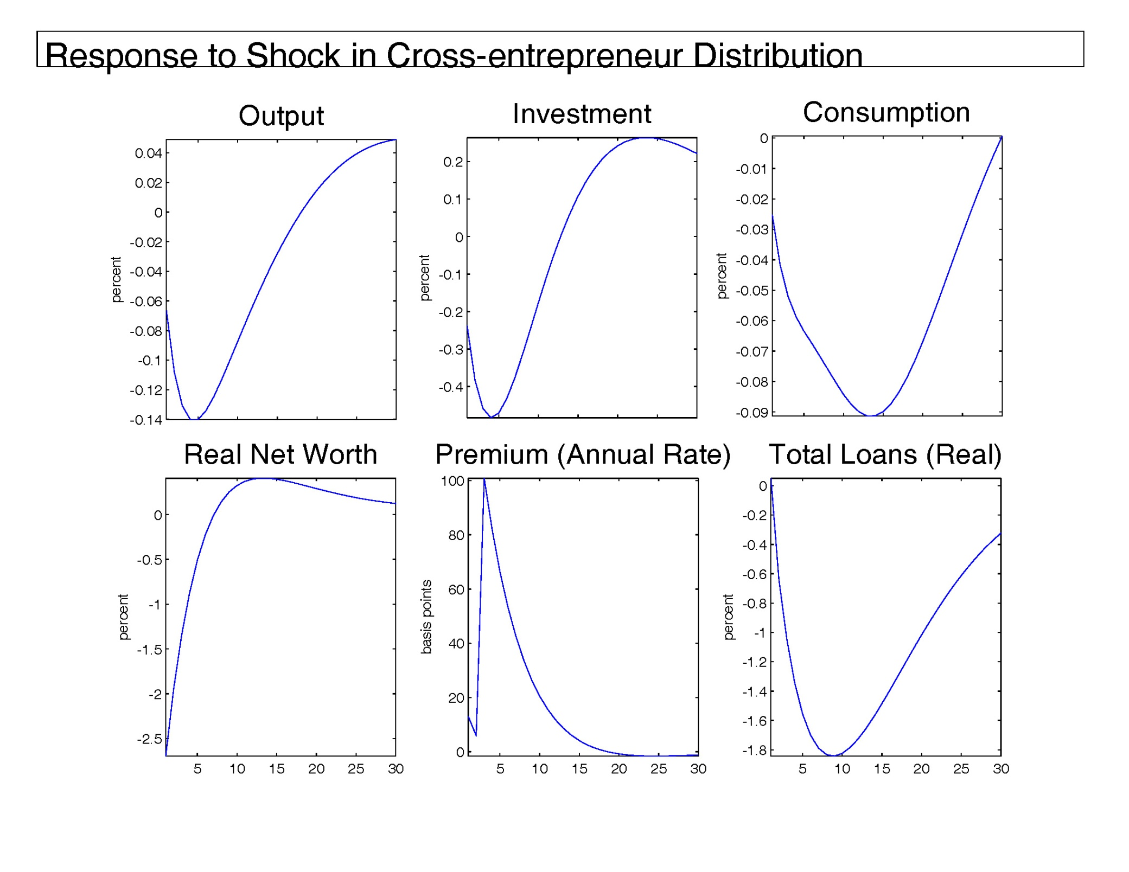

Slide 128
Impact of Financial Frictions on Propagation
Effects of monetary shocks on gdp amplified by BGG financial frictions because P and Y go in same direction.
Effects of technology shocks on gdp mitigated by BGG financial frictions because P and Y go in opposite directions.

Slide 129
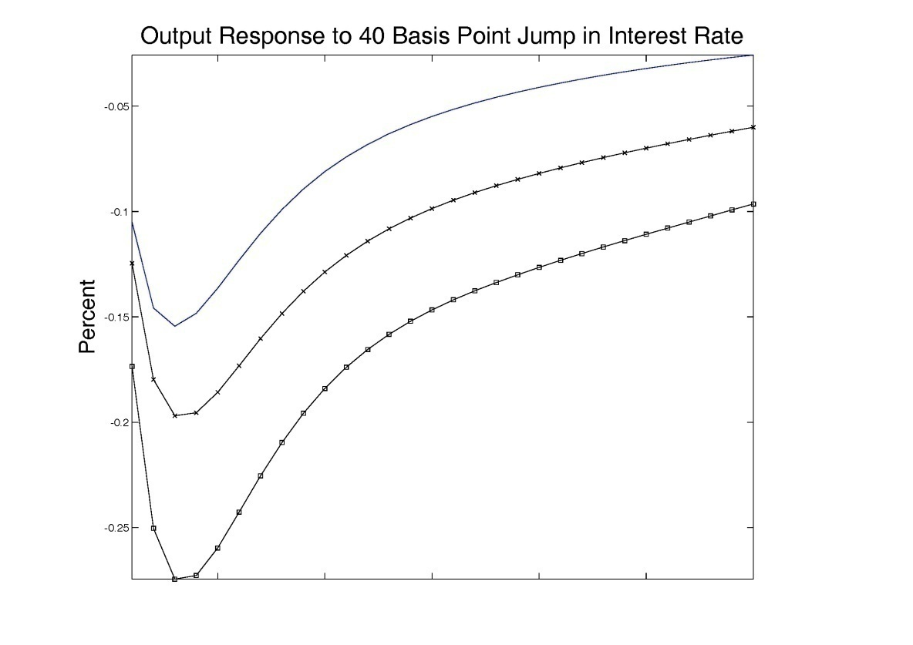
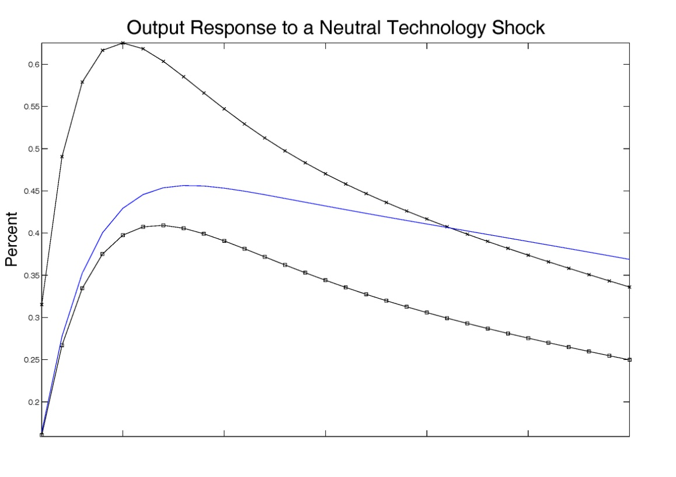
Baseline model with no Fisher Effect
Baseline model
Blue line: baseline model with no financial frictions

Slide 130
Out of Sample RMSEs
There is not a loss of forecasting power with the additional complications of the model.
The model does well on everything, except the risk premium.

Slide 131
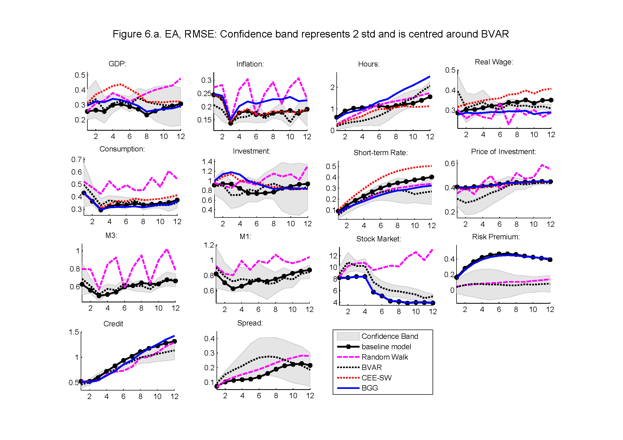

Slide 136
Disappointing!

Slide 138
Models with Financial Frictions Can be Used to Address Important Policy Questions
When there is an increase in risk spreads, how should monetary policy respond?
How should monetary policy react to credit variables and the stock market?
Does monetary policy cause excess asset price volatility?
  Taylor: deviations from Taylor rule may cause asset price volatility
  Christiano-Ilut-Motto-Rostagno: Taylor rule may cause asset price volatility

Slide 139
How Should Policy Respond to the Risk Spread?
Taylor’s recommendation:
Evaluate this proposal by comparing performance of economy with and against Ramsey-optimal benchmark.

Slide 140
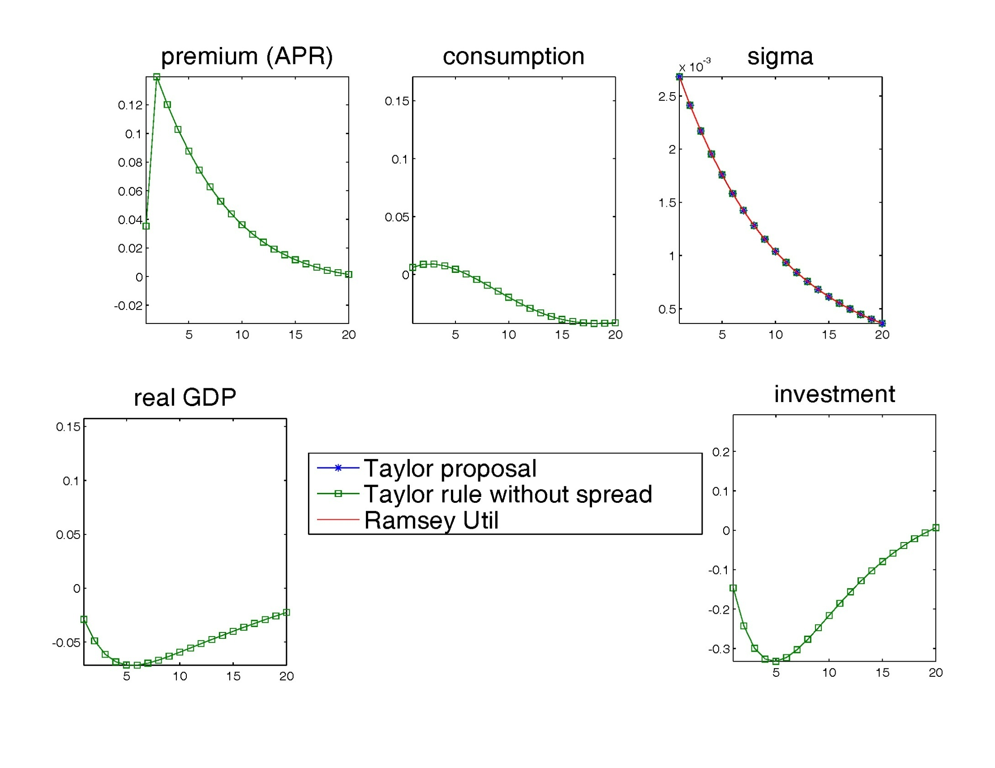

Slide 141
Get a recession, just like in
earlier graph

Slide 142
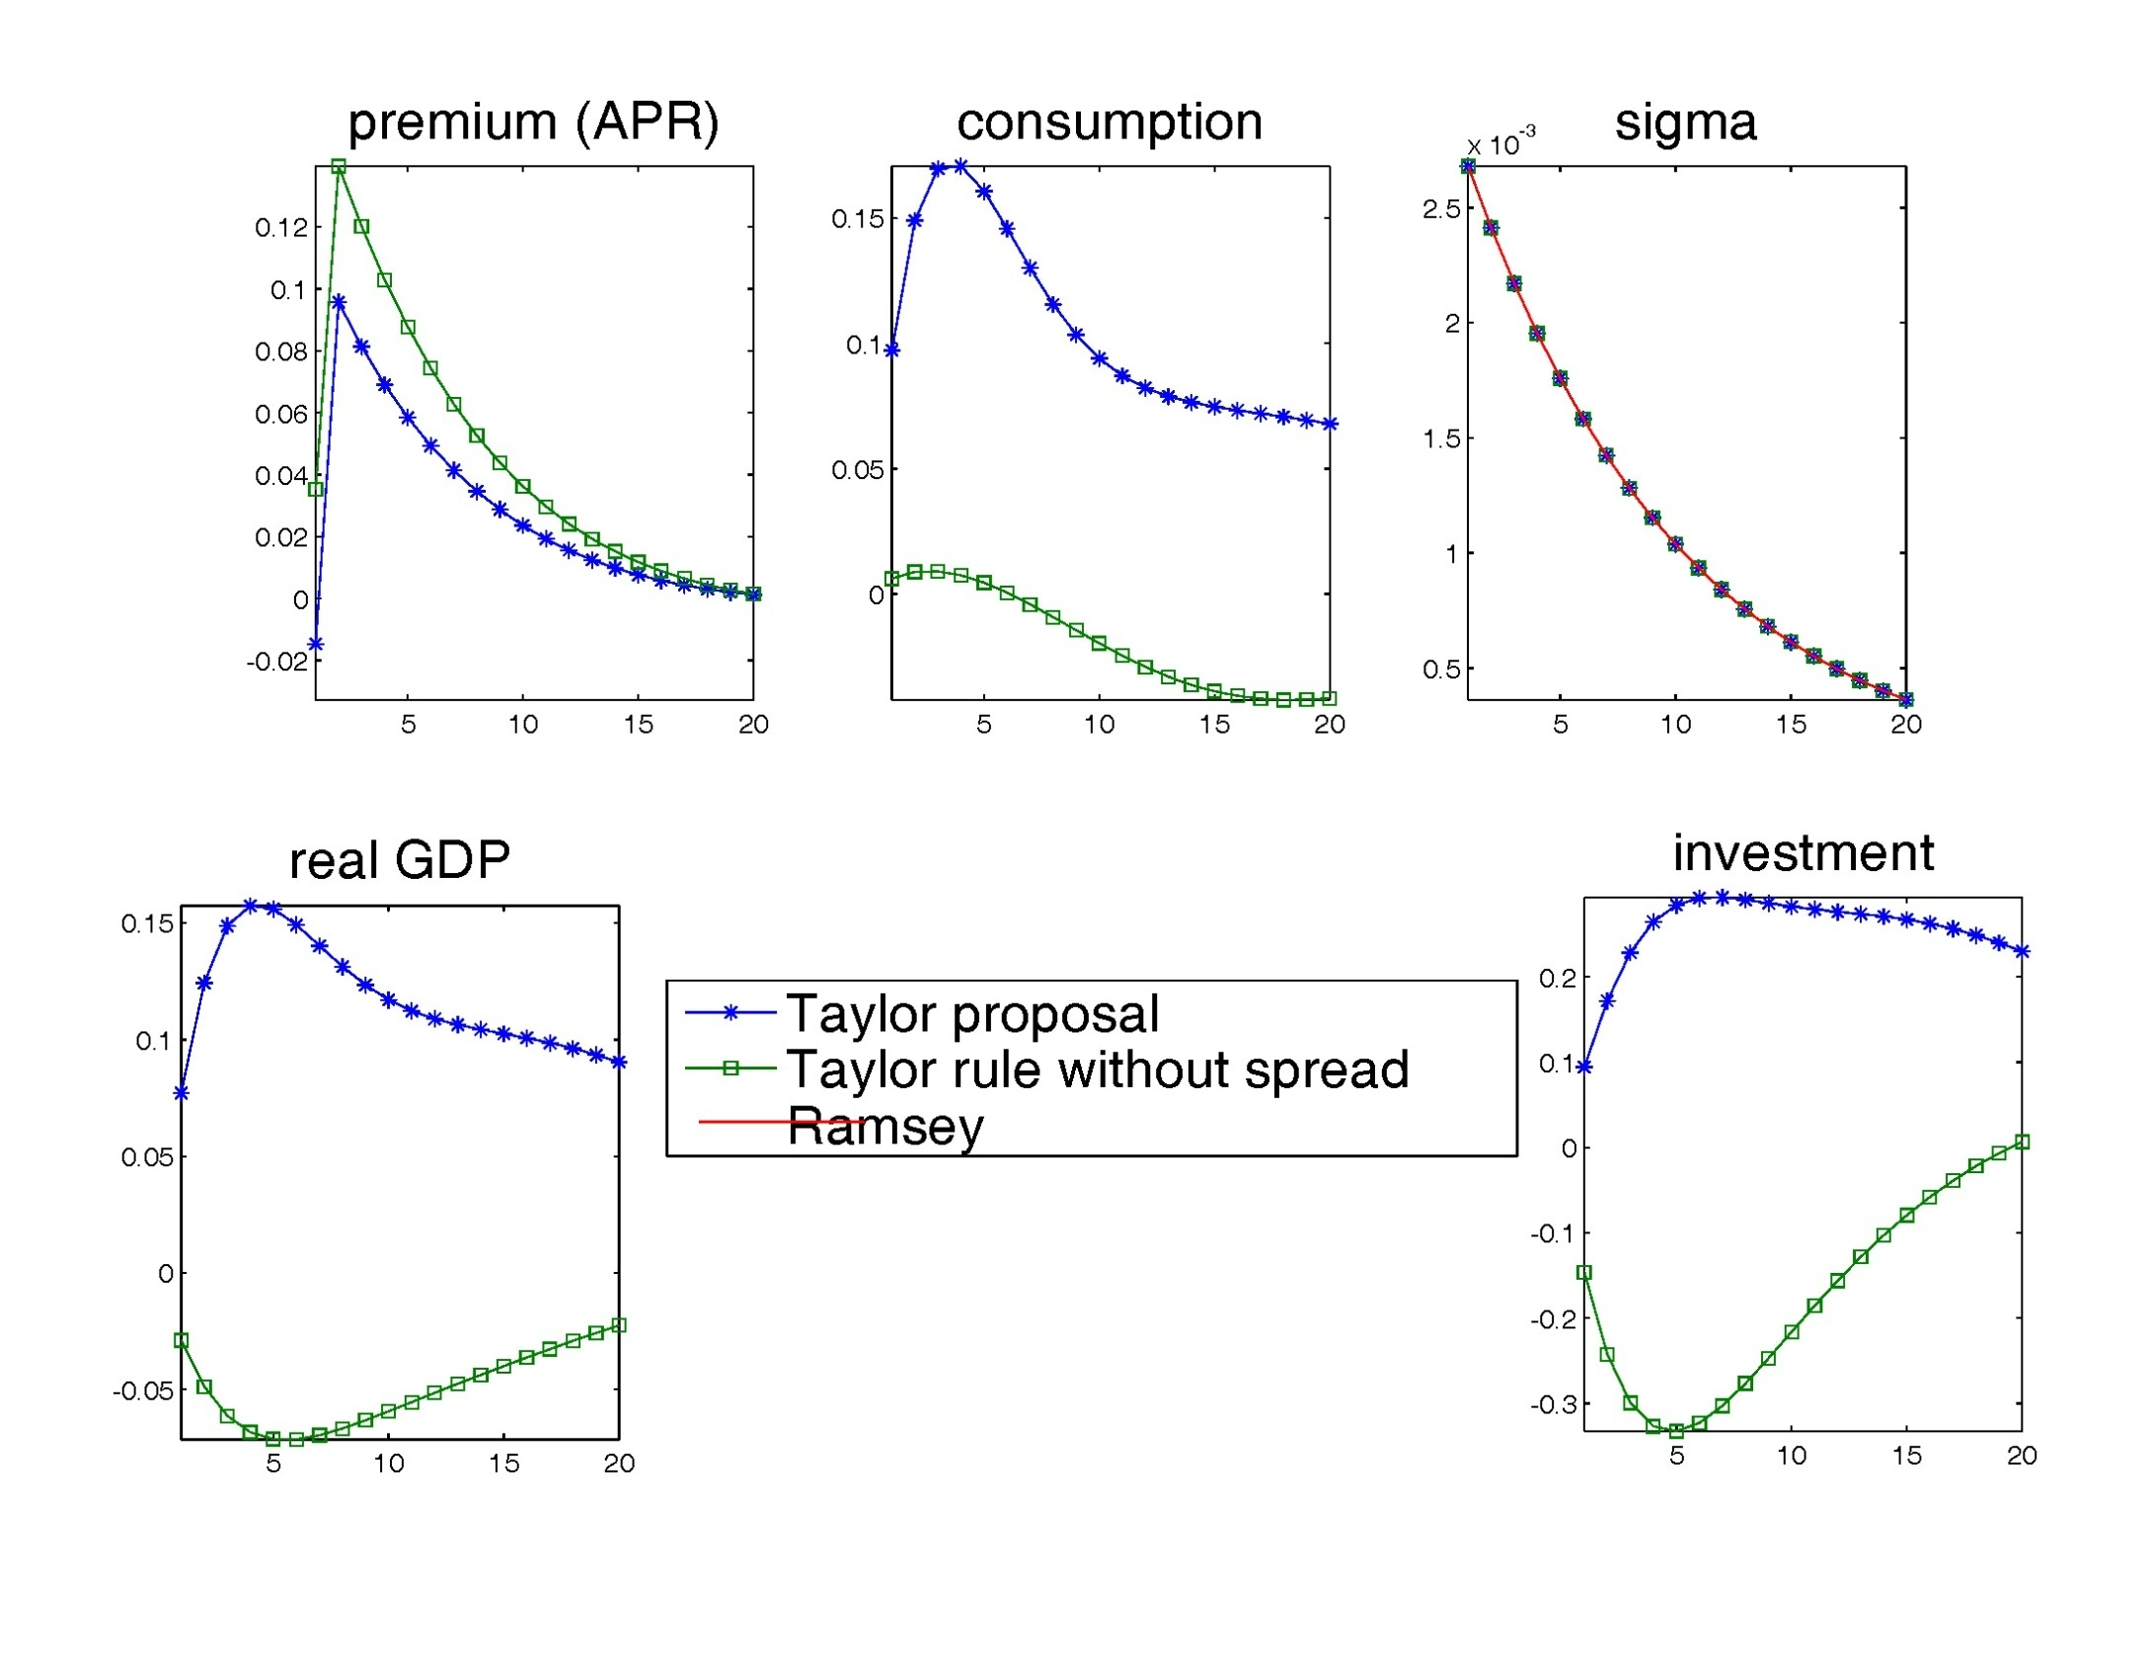

Slide 143
Taylor suggestion creates a boom
Is it too much?

Slide 144
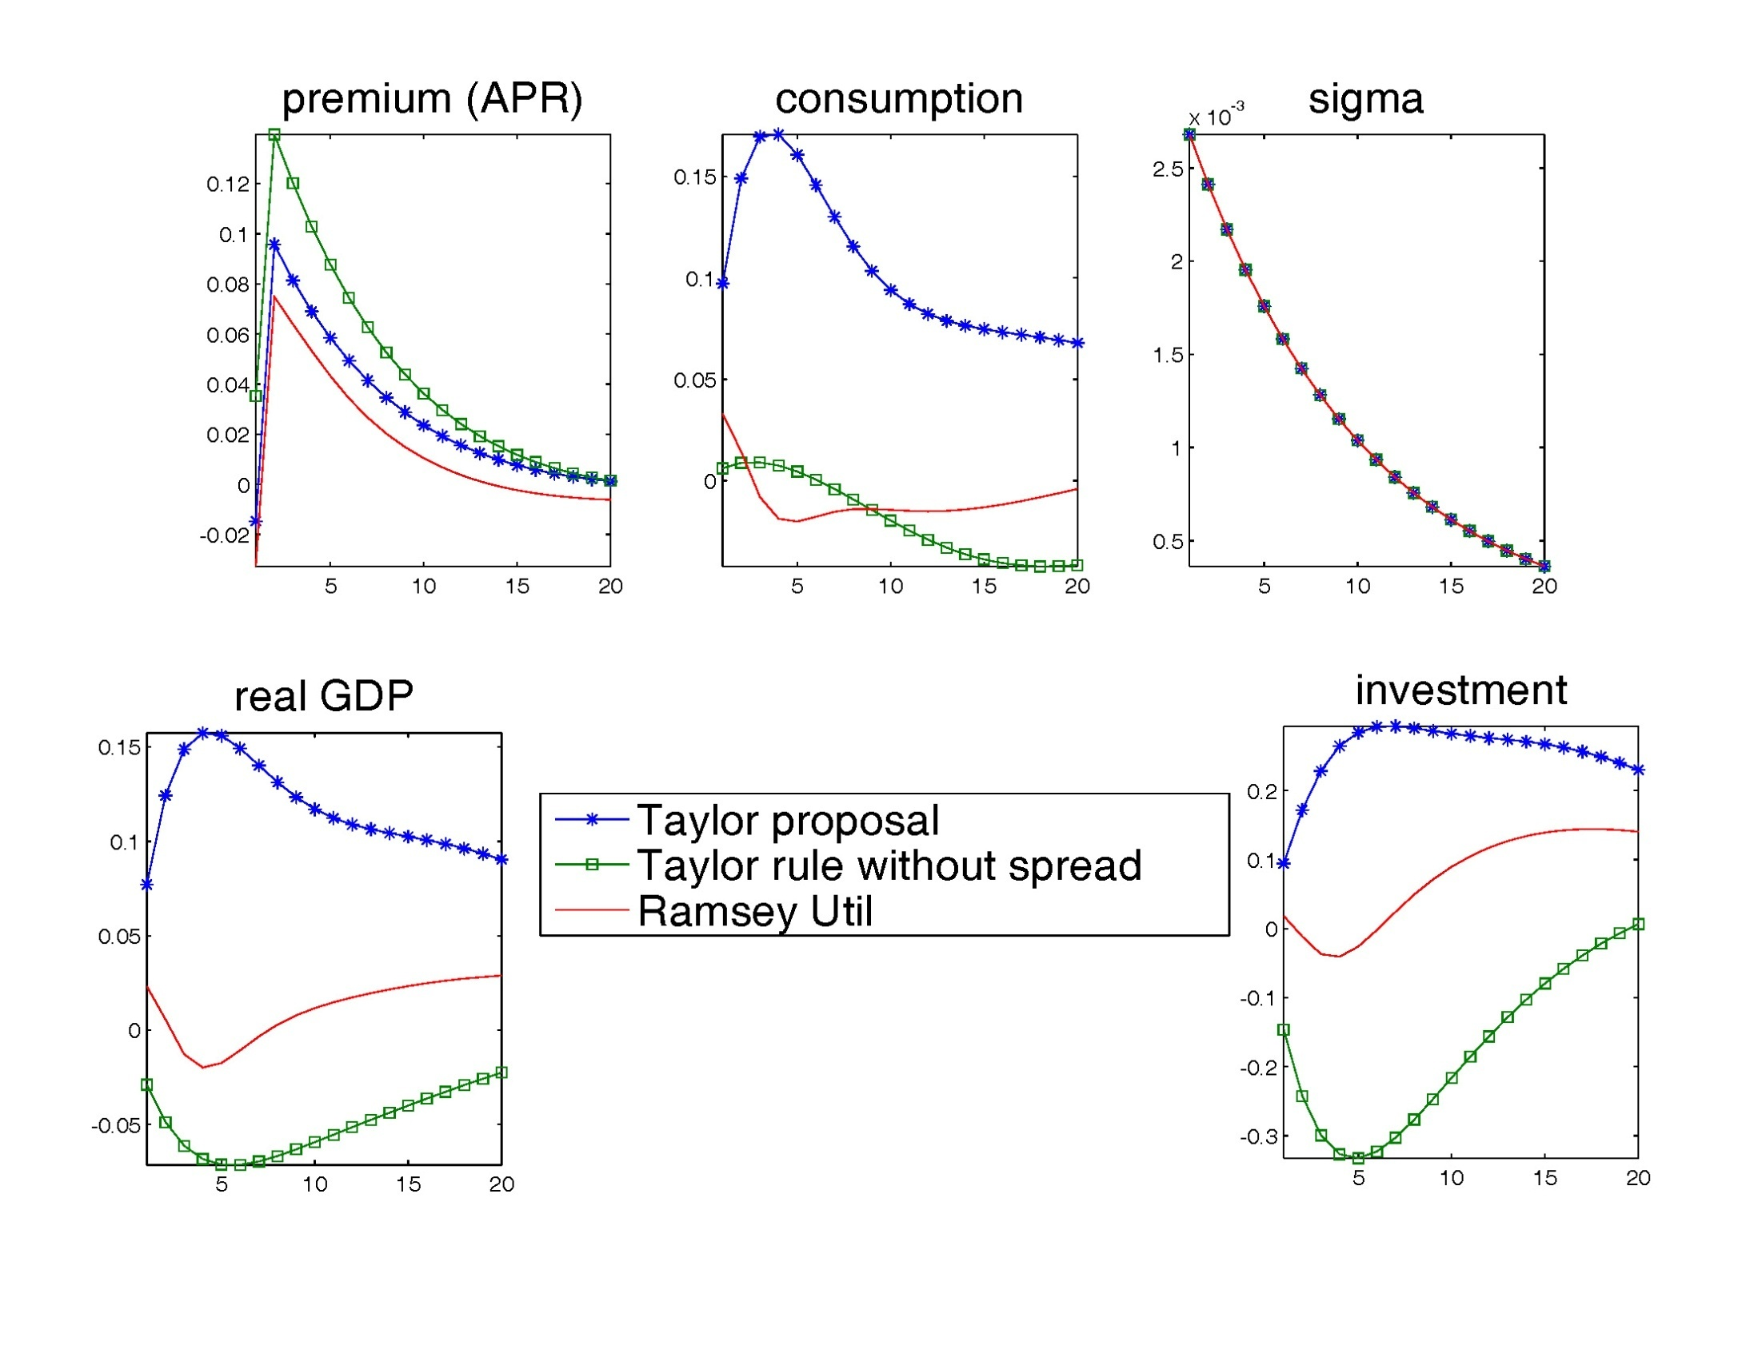

Slide 145
Taylor’s suggestion overstimulates

Slide 146
Conclusion of Empirical Analysis with Financial Frictions
Incorporating financial frictions changes inference about the sources of shocks and of propagation
  risk shock.
  Fisher debt deflation
Opens a range of interesting questions that can be addressed

Slide 147
Extra Slides…

Slide 148
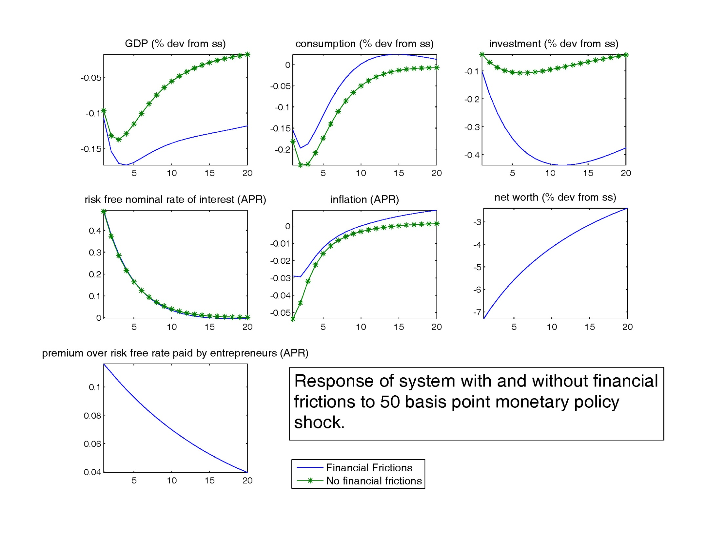
50 basis
point jump
in nominal
rate

Slide 149
Big drop in
investment
and net worth

Slide 150
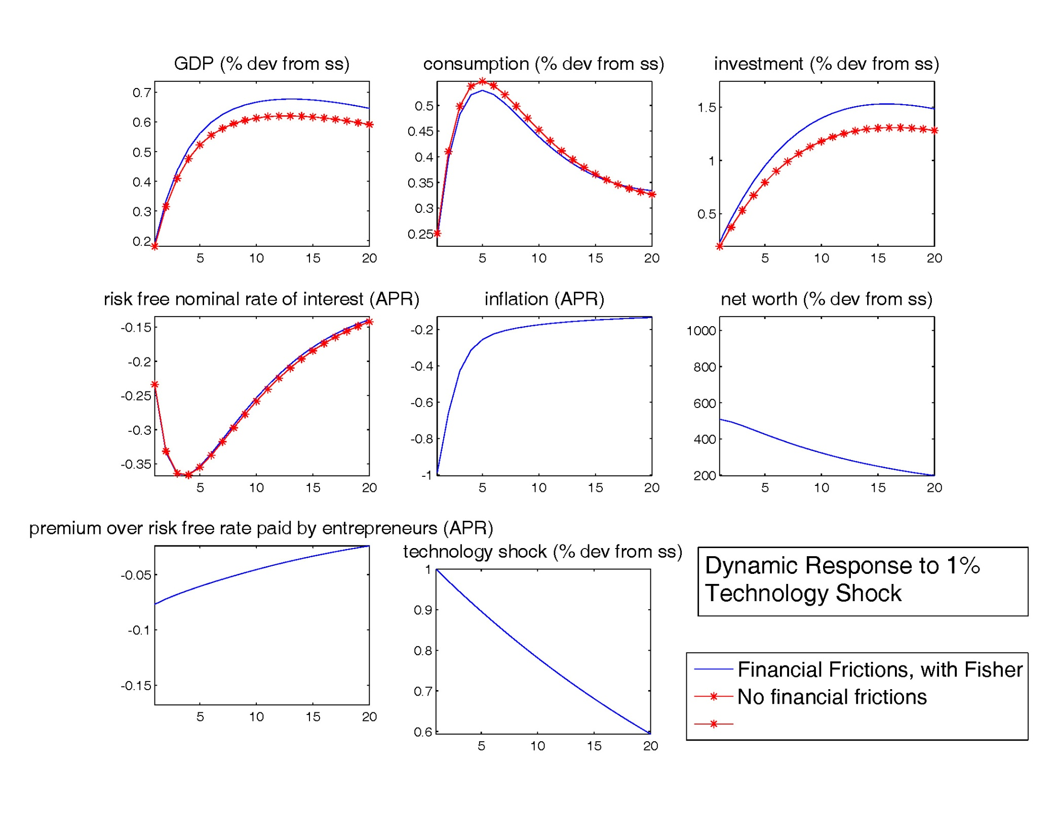

Slide 151
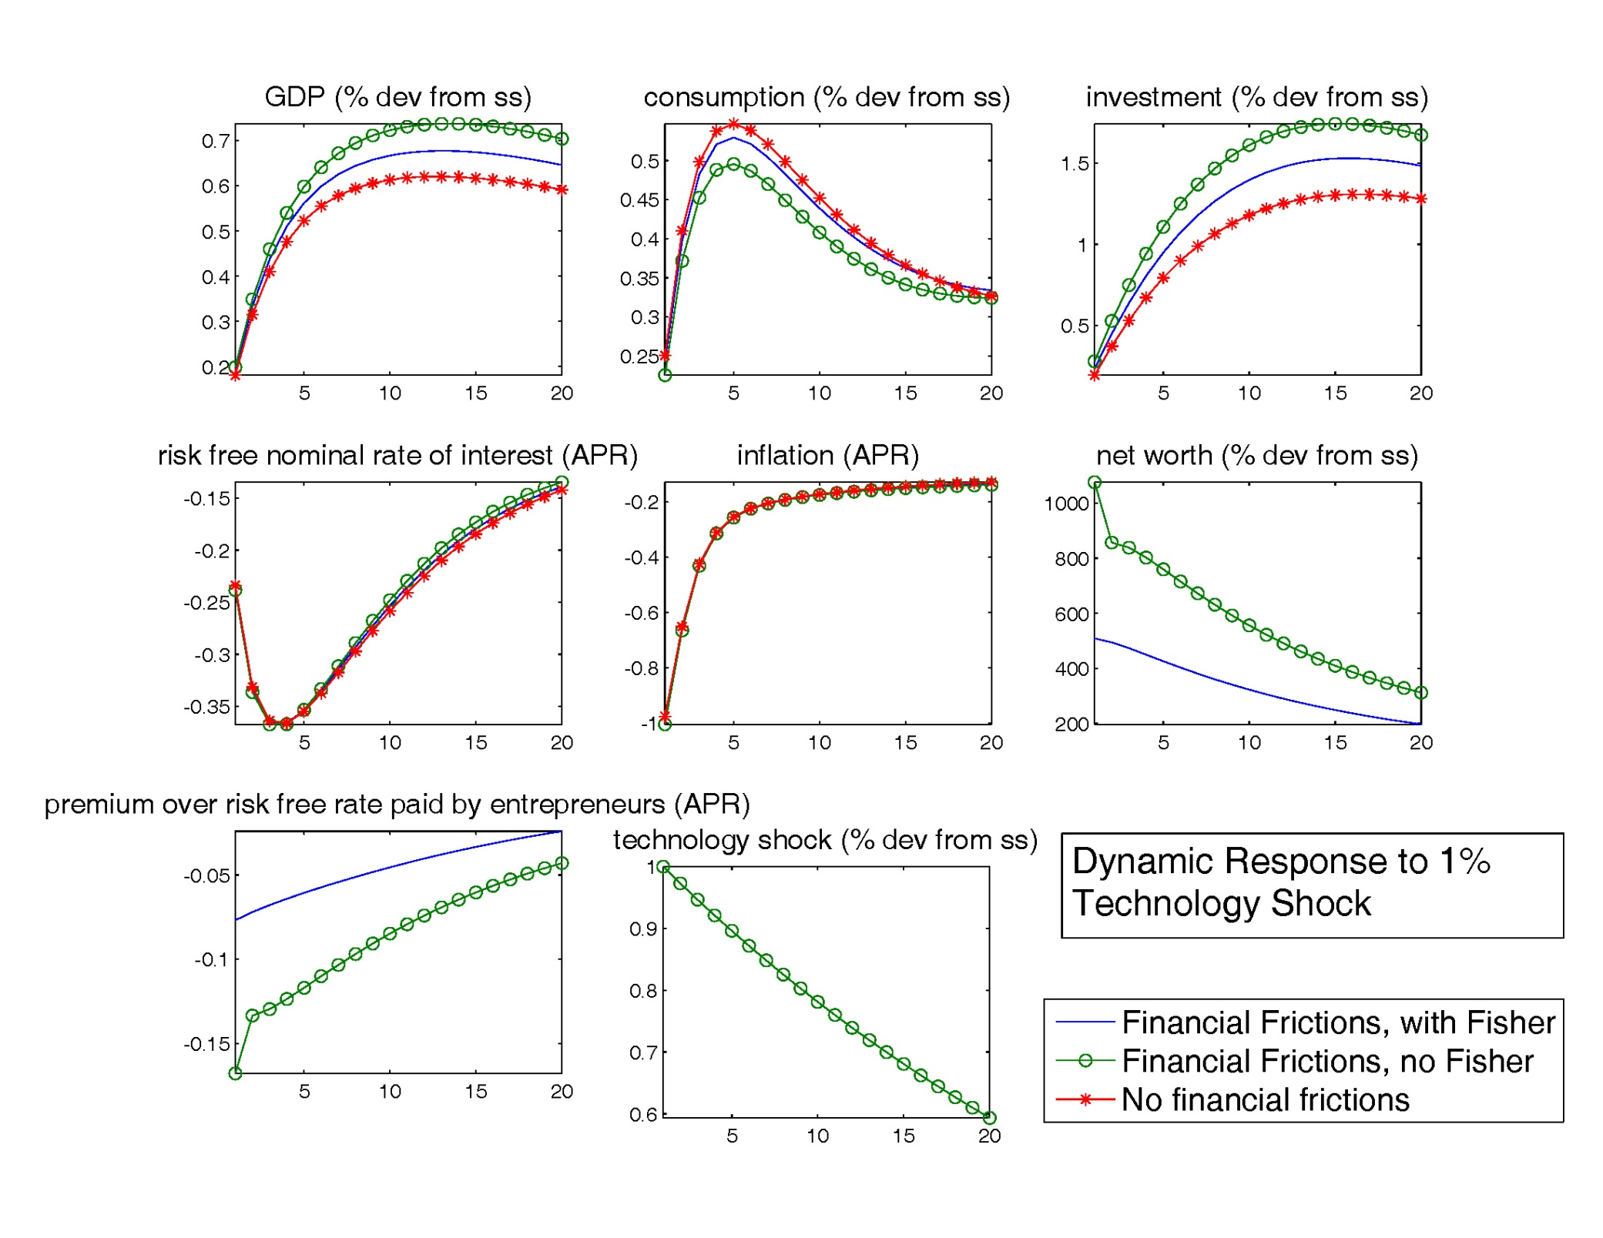
Note: the software for computing these charts may be found at http://faculty.wcas.northwestern.edu/~lchrist/course/financial.htm

Slide 152
Prediction of financial friction model appears to be consistent with empirical evidence.
Chari-Christiano-Kehoe (2008) show:
  Financially constrained firms seem to be more affected by monetary shock than unconstrained (Gertler-Gilchrist)
  Financially constrained and unconstrained firms roughly equally affected over the business cycle.

Slide 153
Delivers new variables such as credit, risk spread
Can ask interesting questions:
  when risk in the economy increases, how should monetary policy react.
  What role should data on credit and on the stock market (the price of capital) play in monetary policy?

Slide 154
Summary
We constructed a dynamic GE model of cyclical fluctuations.
Given assumptions satisfied by our model, we identified dynamic response of key US economic aggregates to 3 shocks
  Monetary Policy Shocks
  Neutral Technology Shocks
  Capital Embodied Technology Shocks
These shocks account for substantial cyclical variation in output.
Estimated GE model does a good job of accounting for response functions (However, Misses on Inflation Response to Neutral Shock)
Our point estimates suggest slope of Phillips curve steep, so there is no micro-macro price puzzle. However, large standard error.
Described extensions of the model.

Slide 155
Summary…
Calvo Sticky Prices and Wages Seems Like Good Reduced Form
  What is the Underlying Structure?
  Is it information frictions?

Slide 156
Modification of labor market
Mortensen-Pissarides search and matching frictions recently introduced into DSGE models (Gertler-Sala-Trigari, Blanchard-Gali, Christiano-Ilut-Motto-Rostagno)
Draw a distinction between hours (‘intensive margin’) and number of workers (‘extensive margin’)
Intensive and extensive margins exhibit very different dynamics over business cycle
Wage frictions thought to matter for extensive margin, not intensive margin.
Extension to open economy (Christiano, Trabandt, Walentin)

Slide 157
Firms
Employment
Agency
Homogeneous Labor
Employment
Agency
unemployment
Employment
Agency
Employment
Agency
Notes:
Discuss the flows here.

Slide 158
Firms
Each period, employment agencies
post vacancies to attract workers
Employment
Agency
Homogeneous Labor
Employment
Agency
unemployment
Employment
Agency
Employment
Agency

Slide 159
Efficient determination of
hours worked in employment agency
marginal benefit of one hour to agency
= marginal cost to worker of one hour
Firms
Employment
Agency
Homogeneous Labor
Employment
Agency
unemployment
Employment
Agency
Employment
Agency
Notes:
Efficiency….hours variation occurs on intensive and extensive margin. Wage frictions can’t have an effect on the intensive margin in this model.

Slide 160
Taylor wage contracting
Employment agencies equally divided between
N cohorts. Each period one cohort negotiates
an N-period wage with its workers.
Firms
Employment
Agency
Homogeneous Labor
Employment
Agency
unemployment
Employment
Agency
Employment
Agency
Notes:
Here are the sticky wages

